Slide 1

The Turnout Tracker
Jonathan Tannen

Slide 2
sixty-six wards
- A datascience blog about Philadelphia Politics.
“FiveThirtyEight for Philadelphia”
www.sixtysixwards.com
For me the challenges are
rigor with simplification
storytelling.
Alternatively: Question formation.
Alternatively 2: The killer plot.

Slide 3
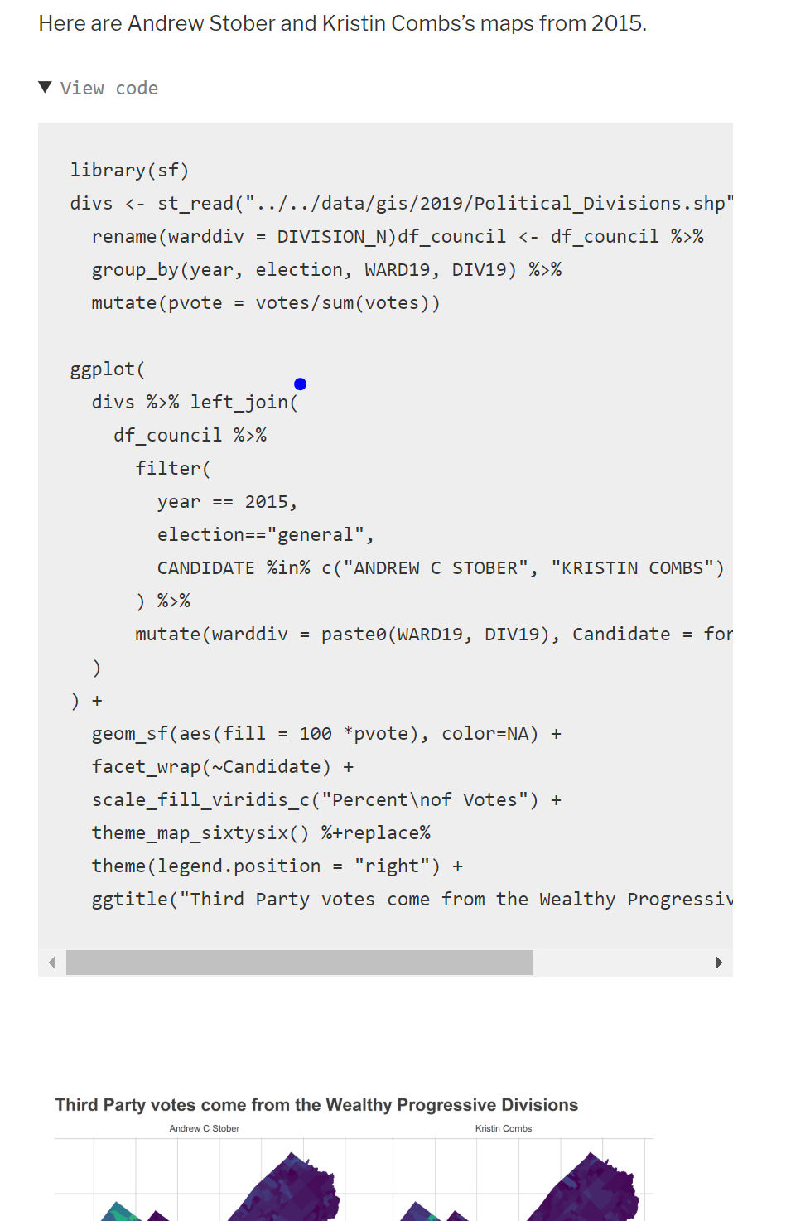
sixty-six wards
- A datascience blog about Philadelphia Politics.
“FiveThirtyEight for Philadelphia”
www.sixtysixwards.com

Slide 4
Today
Two data visualization stories:
The Turnout Tracker
(Maybe) Philadelphia Voting Blocs

Slide 5
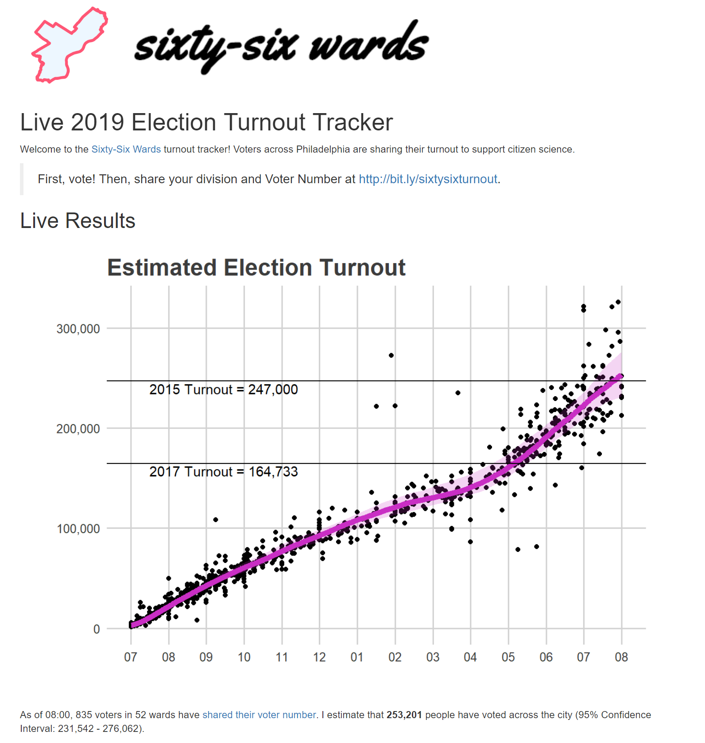
The Turnout Tracker
NOTE: This is not an example of expected work for this course.

Slide 6
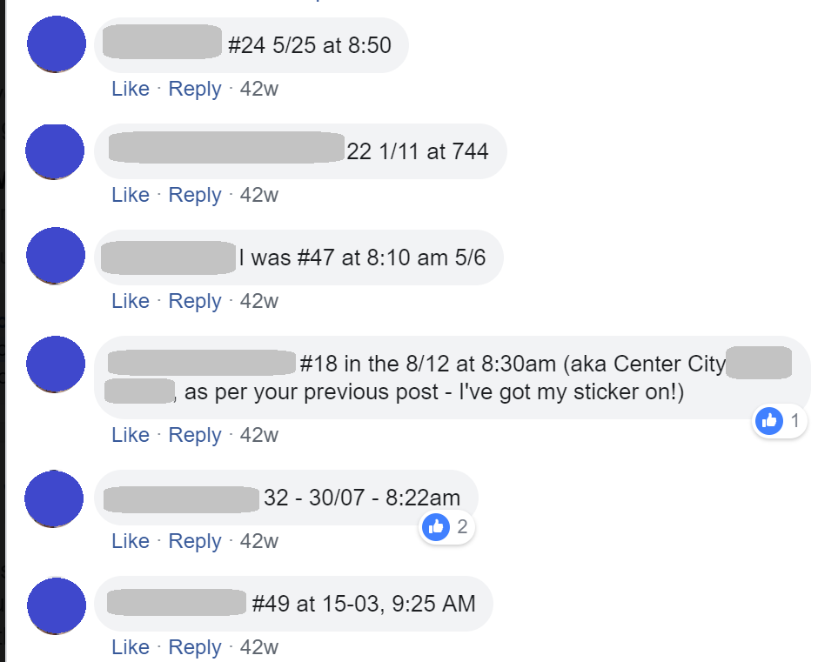
The Turnout Tracker
If people share where and when they vote in real time, can we predict total turnout?

Slide 7
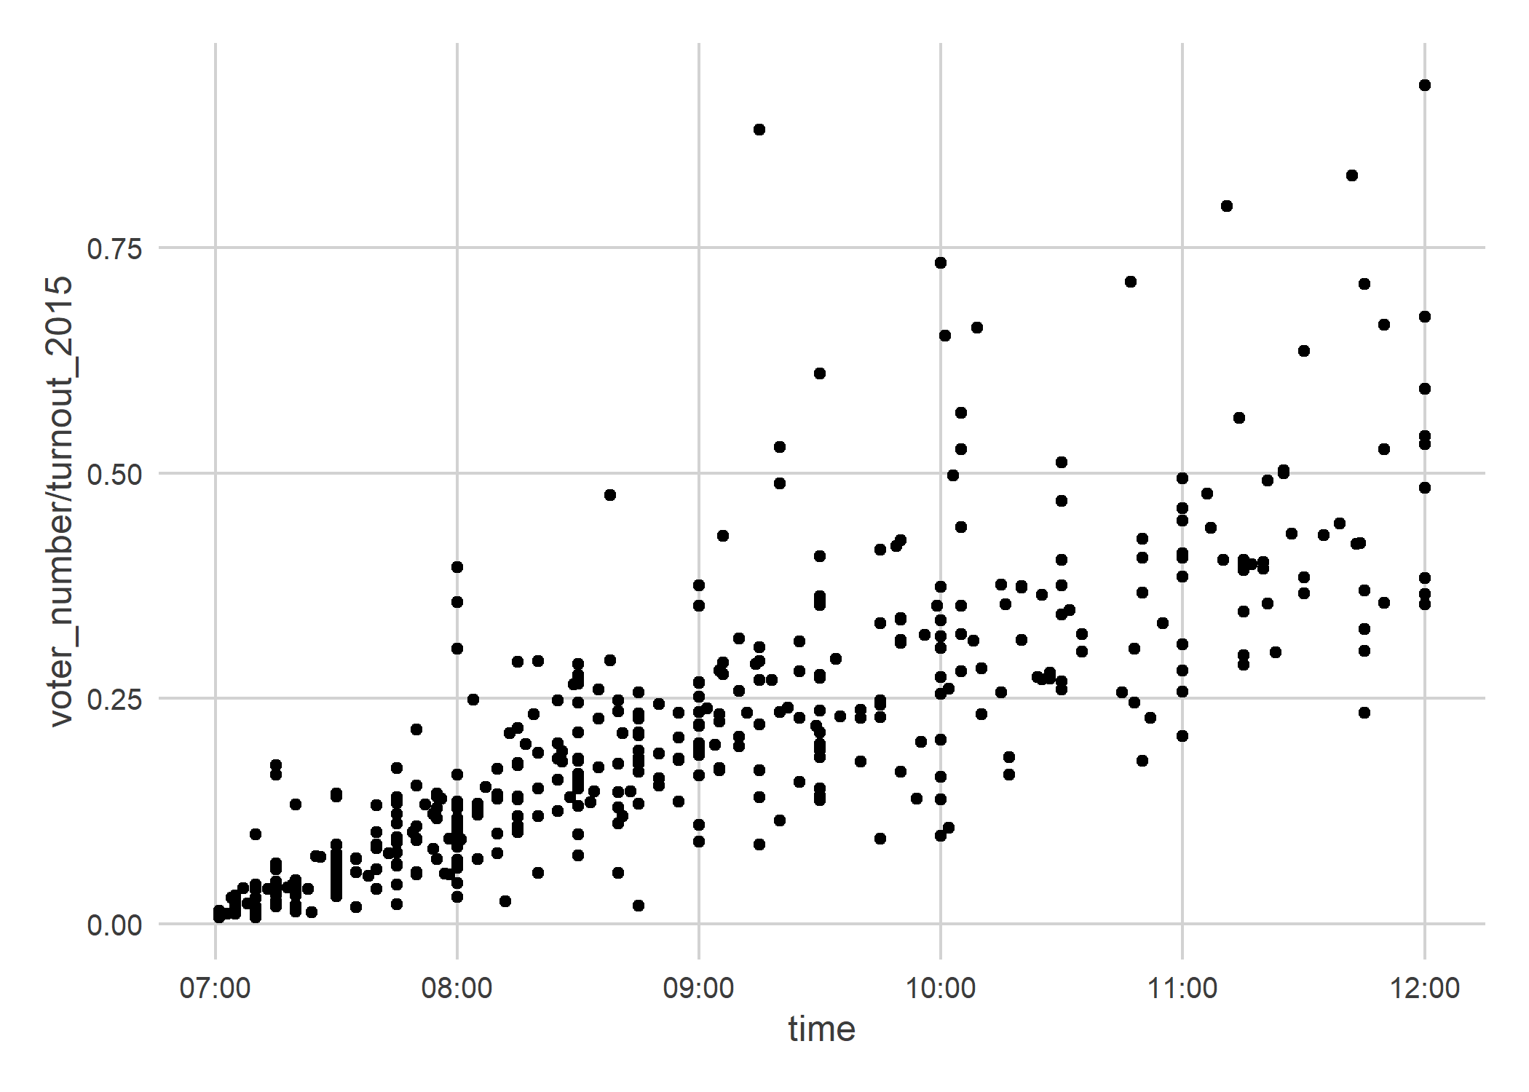
The Turnout Tracker

Slide 8
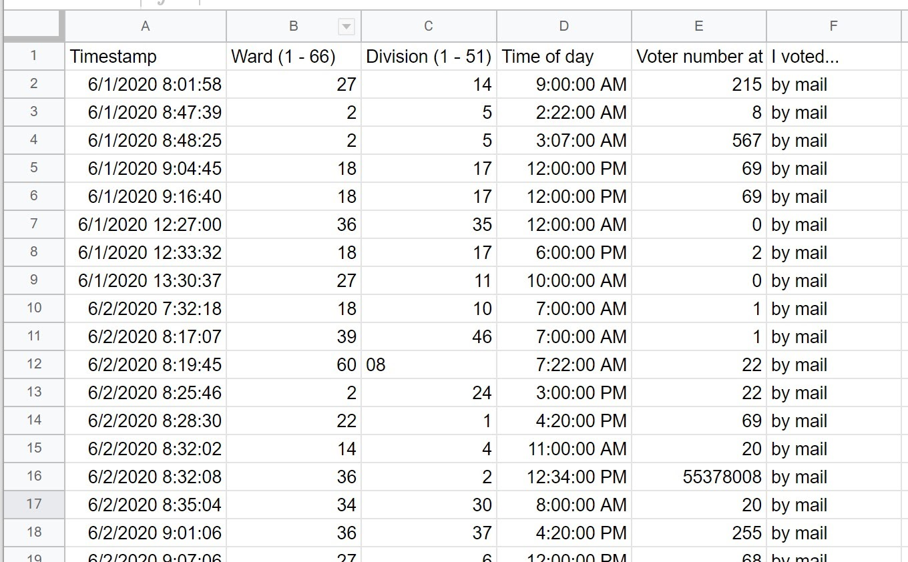
The Turnout Tracker

Slide 9
The Turnout Tracker

Slide 10
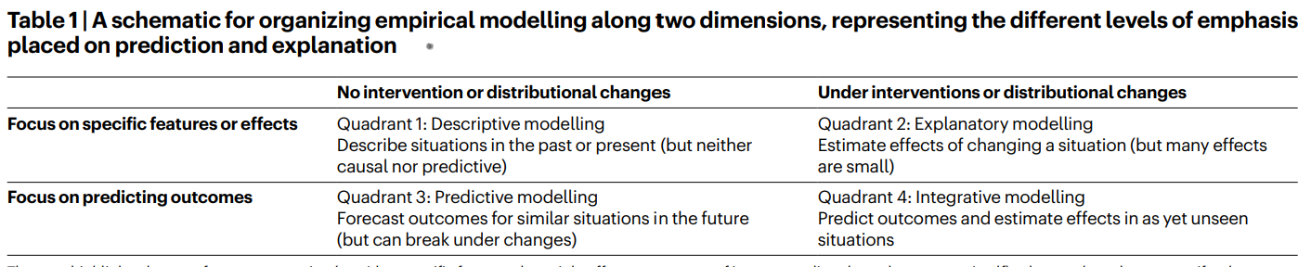
A meta view: the nature of this work
From Hofman, J.M., Watts, D.J., Athey, S. et al. Integrating explanation and prediction in computational social science. Nature 595, 181–188 (2021).

Slide 11
Meta takeaways
Understanding-focused approach to statistical modeling.
Practical full-stack problem solving.
It’s crucial that we build systems & playbooks for this style of work.

Slide 12

A naïve approach
$x_{i}$ = response i
$t_{i}$ = time of response i (in hours)
$d_{i}$ = division of response i
$T_{y}$ = City-wide turnout in year y
$T_{d,y}$ = Final turnout for division d in year y
Estimate…
$$\frac{x_{i}}{T_{d_{i}, 2015}}=βt_{i}+ε_{i}$$
${\hat{T}}_{2019}=T_{2015}⋅\hat{β}⋅13$
What would be wrong?

Slide 13

Turnout Tracker: the challenges
Different divisions have different baseline turnouts.
Divisions may swing together.
We don’t know the time pattern.
There’s *definitely* selection bias into who shares.
Knowing uncertainty in the estimate is everything.
$$\log\left(x_{i}\right)=α_{y}+μ_{d_{i}}+γ_{d_{i}y}+f_{y}\left(t_{i}\right)+e_{i}$$

Slide 14

Turnout Tracker: the model
At time $t$ in division $d$, year $y$ the voter number $x_{i}$ so far is
$$\log\left(x_{i}\right)=α_{y}+μ_{d_{i}}+γ_{d_{i}y}+f_{y}\left(t_{i}\right)+e_{i}$$

Slide 15
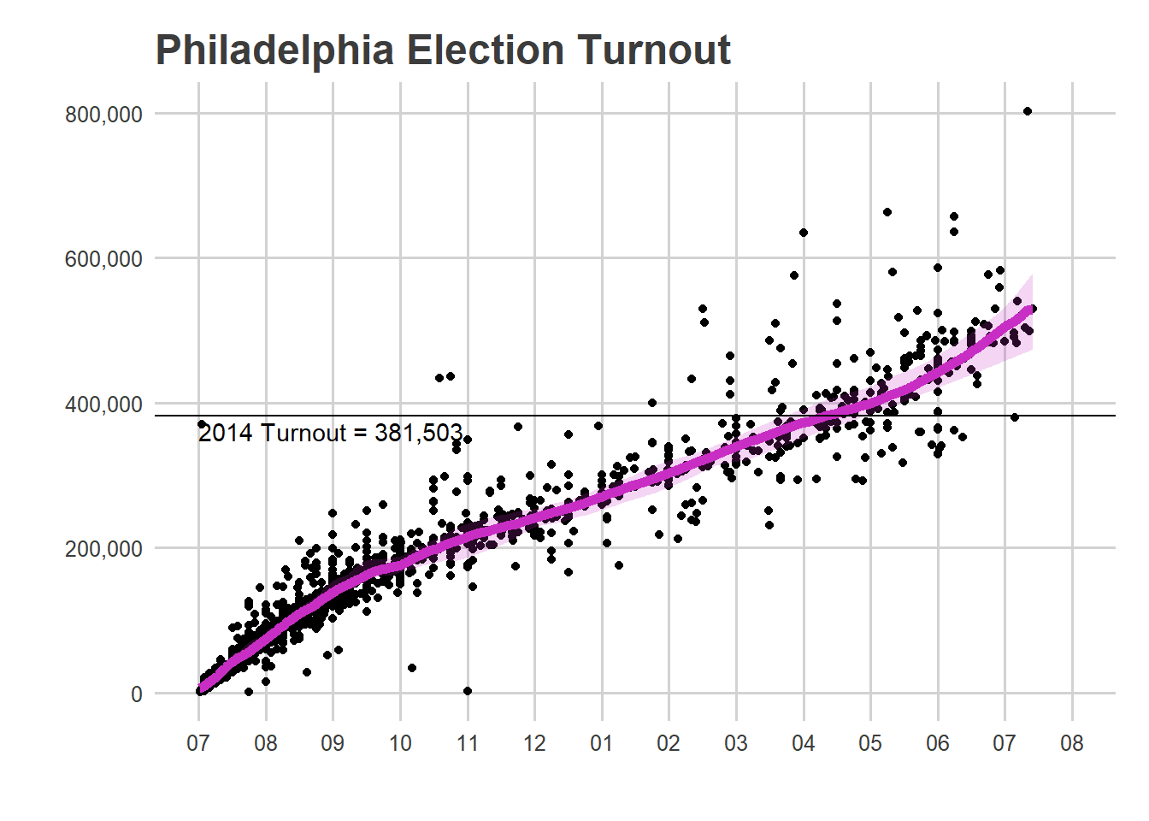
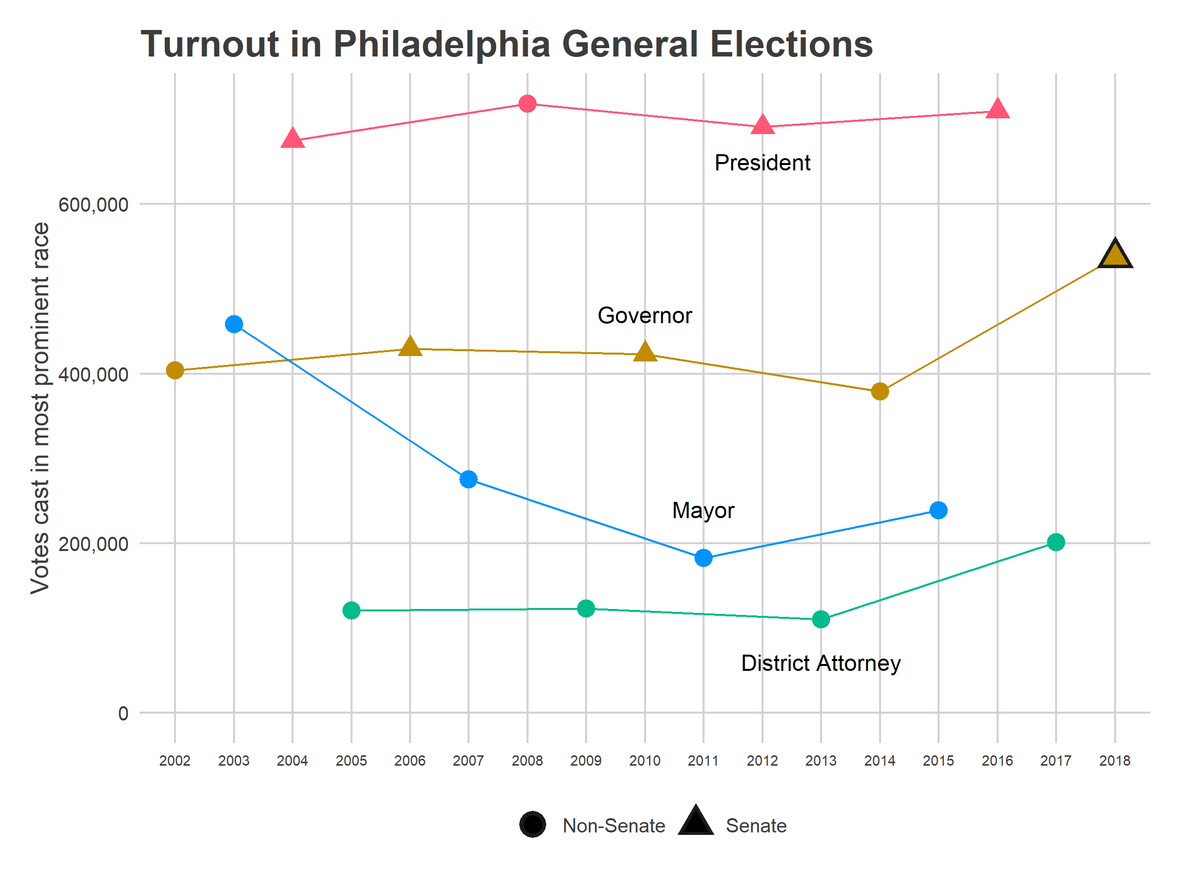
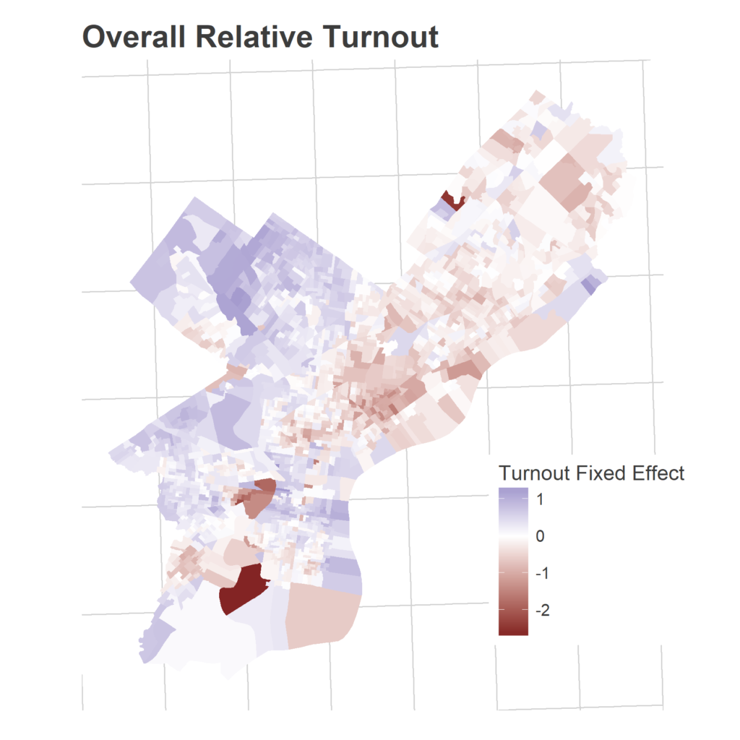
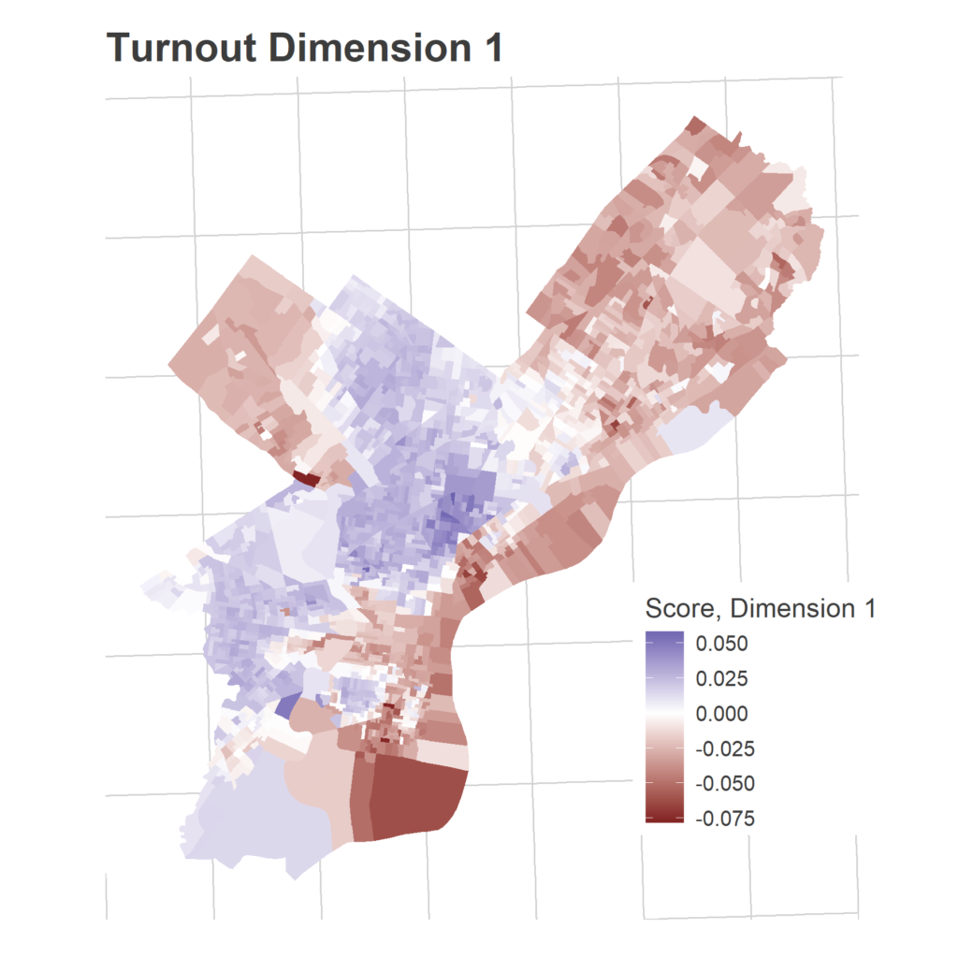
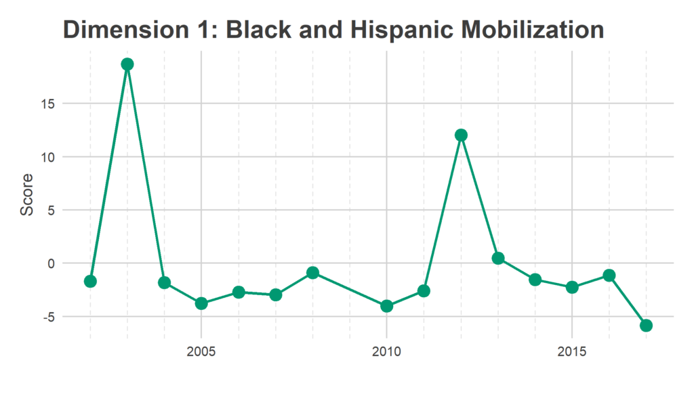

Turnout Tracker: the model
At time $t$ in division $d$, year $y$ the voter number $x_{i}$ so far is
$$\log\left(x_{i}\right)=α_{y}+μ_{d_{i}}+γ_{d_{i}y}+f_{y}\left(t_{i}\right)+e_{i}$$
Overall turnout for this year
Time pattern
Usual turnout for this division
This year’s “swing” for the division

Slide 16

Predicting this model
$$\log\left(x_{i}\right)=α_{y}+μ_{d_{i}}+γ_{d_{i}y}+f_{y}\left(t_{i}\right)+e_{i}$$
Estimate $μ_{d_{i}}$ from historic data.

Slide 17
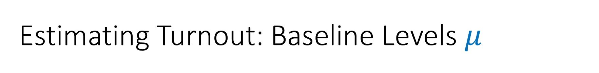
Estimating Turnout: Baseline Levels $μ$

Slide 18
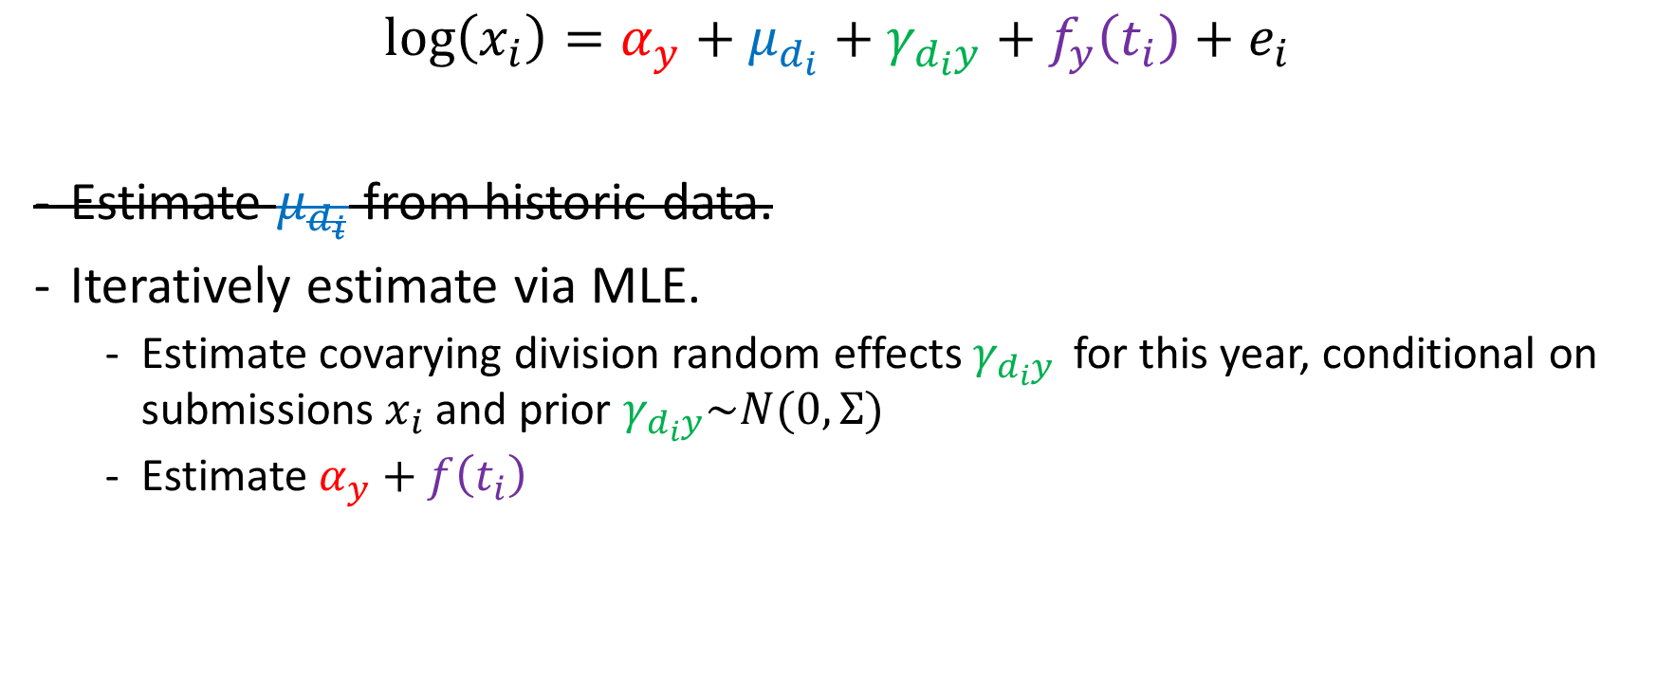
Predicting this model
$$\log\left(x_{i}\right)=α_{y}+μ_{d_{i}}+γ_{d_{i}y}+f_{y}\left(t_{i}\right)+e_{i}$$
Estimate $μ_{d_{i}}$ from historic data.
Iteratively estimate via MLE.
Estimate covarying division random effects $γ_{d_{i}y }$ for this year, conditional on submissions $x_{i}$ and prior $γ_{d_{i}y}\sim N(0, Σ)$
Estimate $α_{y}+f\left(t_{i}\right)$

Slide 19
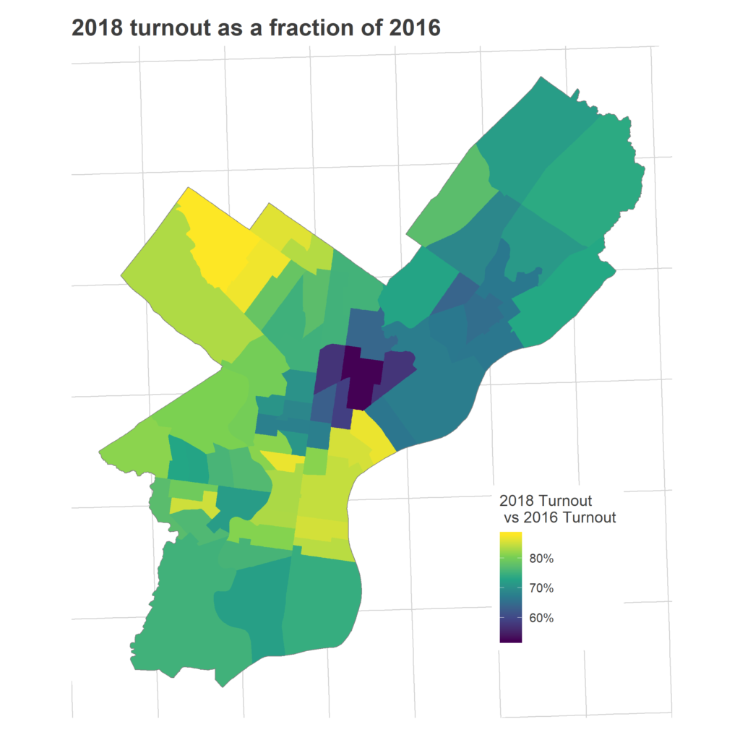
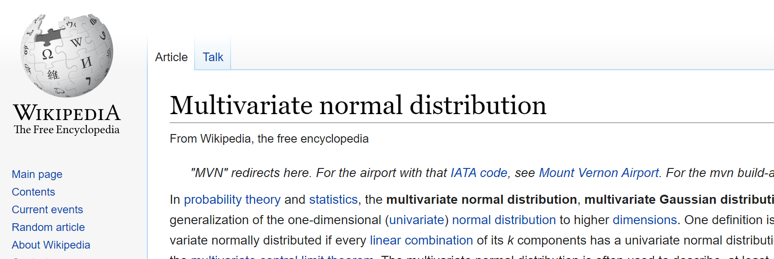
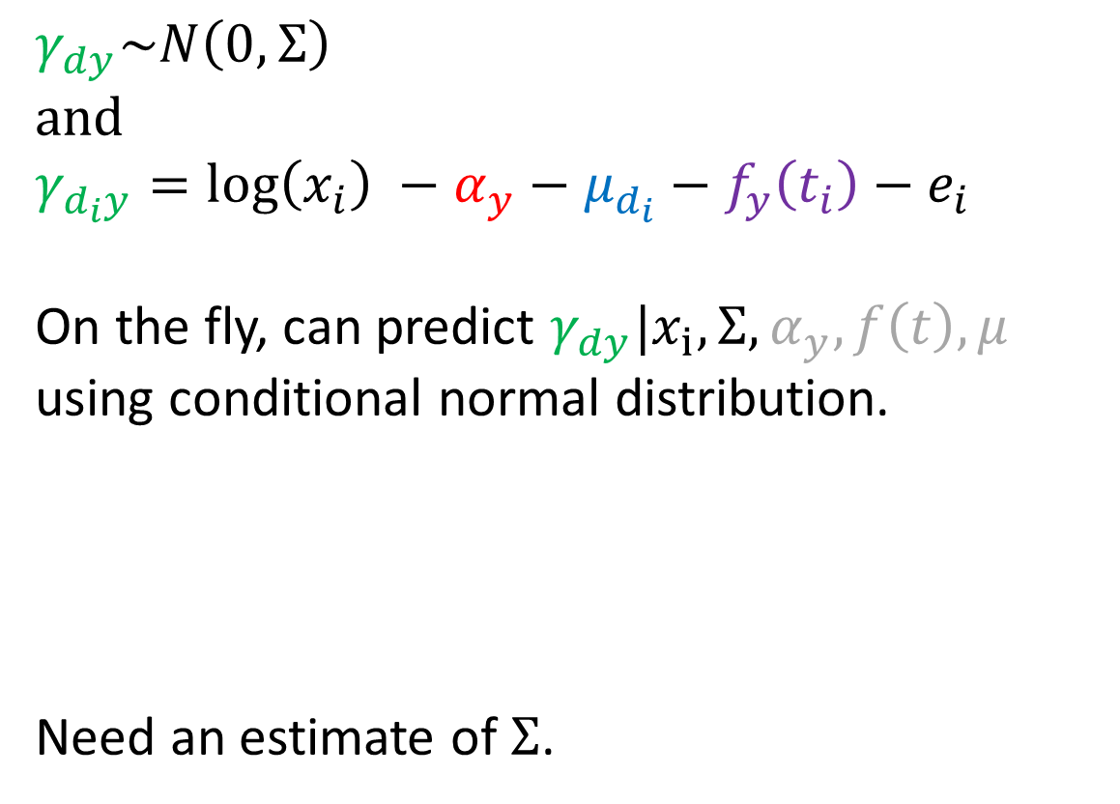
Estimating Random Effects
$$γ_{dy}\sim N\left(0, Σ\right)$$
and
$$γ_{d_{i}y}=\log\left(x_{i}\right) −α_{y}−μ_{d_{i}}−f_{y}\left(t_{i}\right)−e_{i}$$
On the fly, can predict $γ_{dy}|x_{i}, Σ, α_{y}, f\left(t\right), μ$
using conditional normal distribution.
Need an estimate of $Σ$.

Slide 20
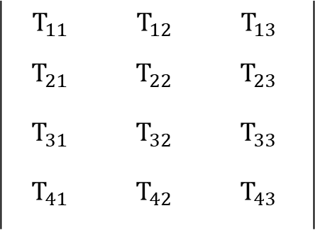
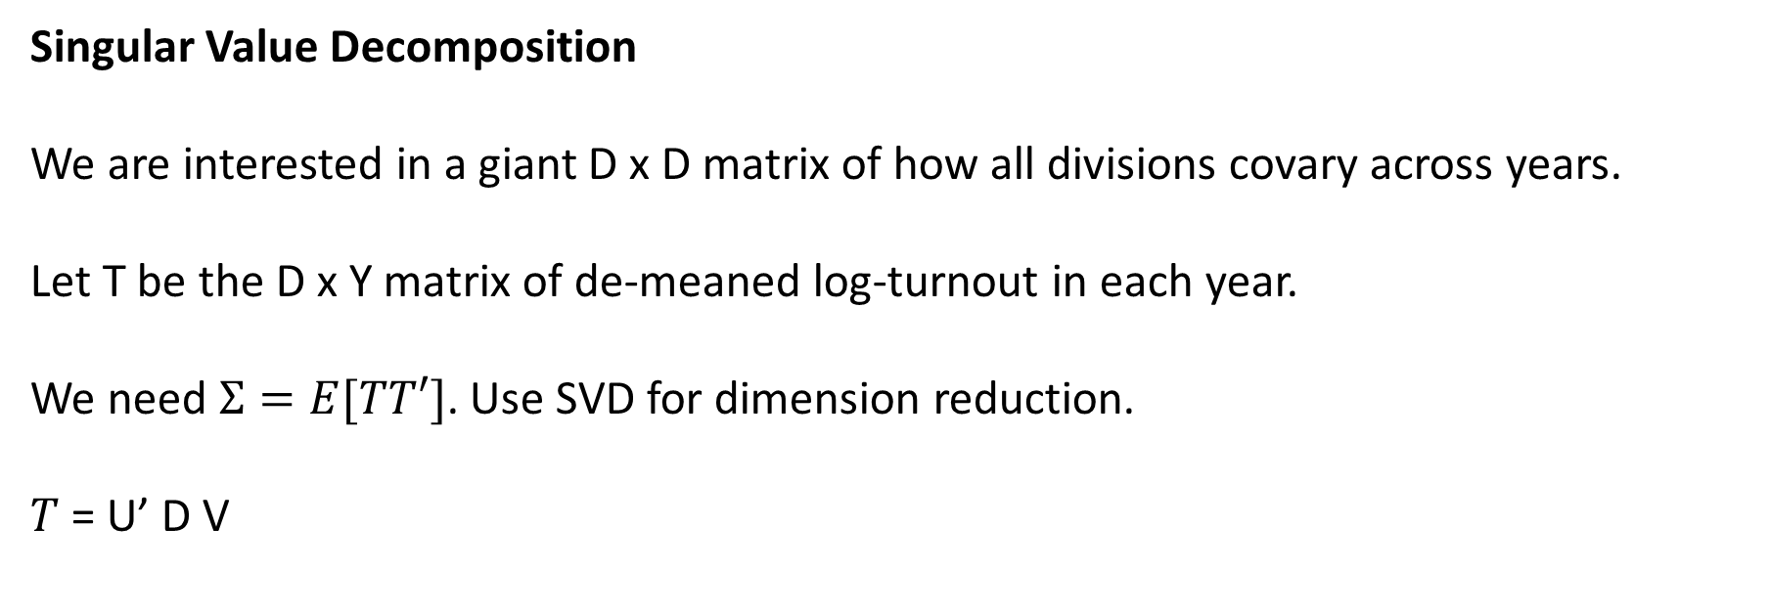
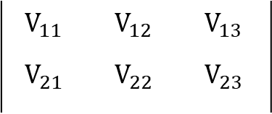
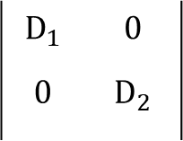
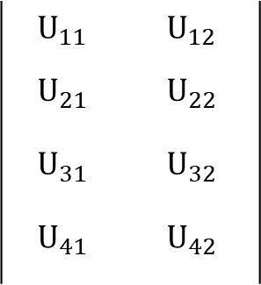
Estimating Turnout: Correlated Districts
Singular Value Decomposition
We are interested in a giant D x D matrix of how all divisions covary across years.
Let T be the D x Y matrix of de-meaned log-turnout in each year.
We need $Σ=E[TT′]$. Use SVD for dimension reduction.
$T$ = U’ D V
$$T_{11}$$ | $$T_{12}$$ | $$T_{13}$$
$$T_{21}$$ | $$T_{22}$$ | $$T_{23}$$
$$T_{31}$$ | $$T_{32}$$ | $$T_{33}$$
$$T_{41}$$ | $$T_{42}$$ | $$T_{43}$$
$$U_{11}$$ | $$U_{12}$$
$$U_{21}$$ | $$U_{22}$$
$$U_{31}$$ | $$U_{32}$$
$$U_{41}$$ | $$U_{42}$$
$$D_{1}$$ | $$0$$
$$0$$ | $$D_{2}$$
$$V_{11}$$ | $$V_{12}$$ | $$V_{13}$$
$$V_{21}$$ | $$V_{22}$$ | $$V_{23}$$
=

Slide 21
Estimating Turnout: Correlated Districts

Slide 22
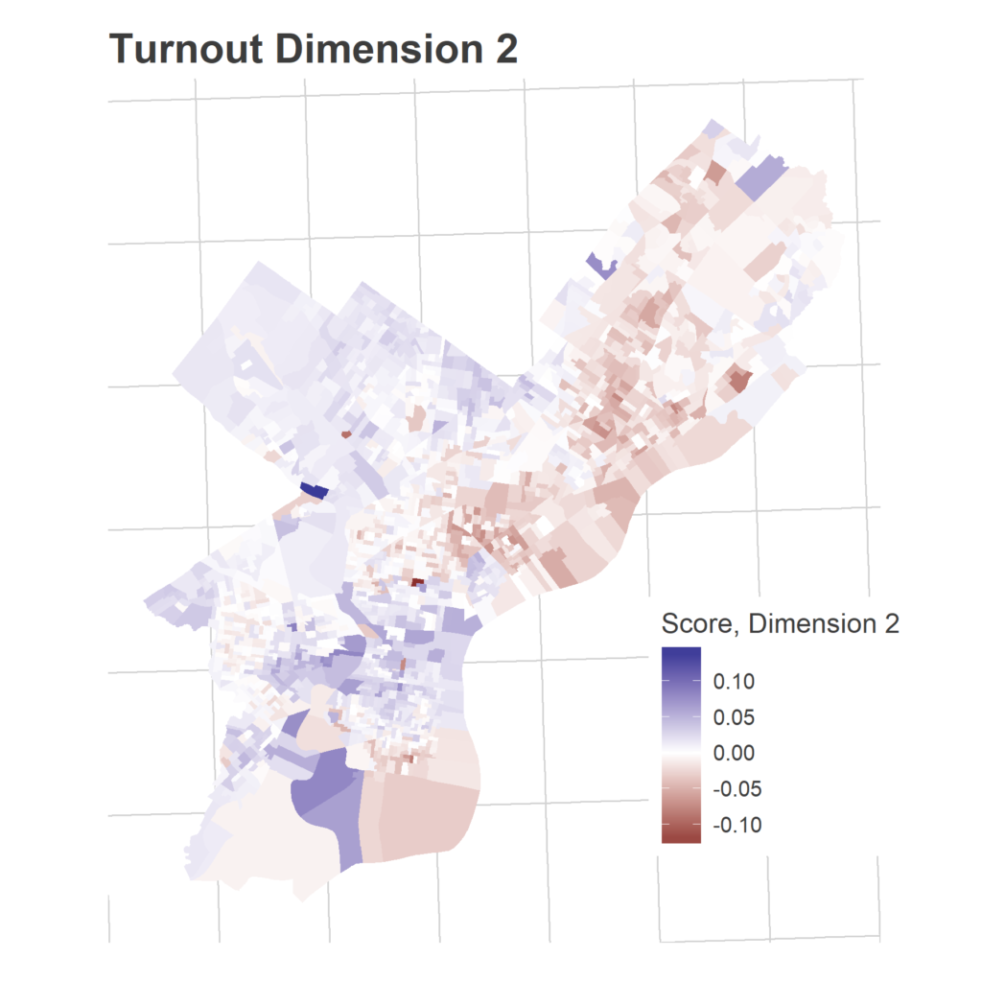
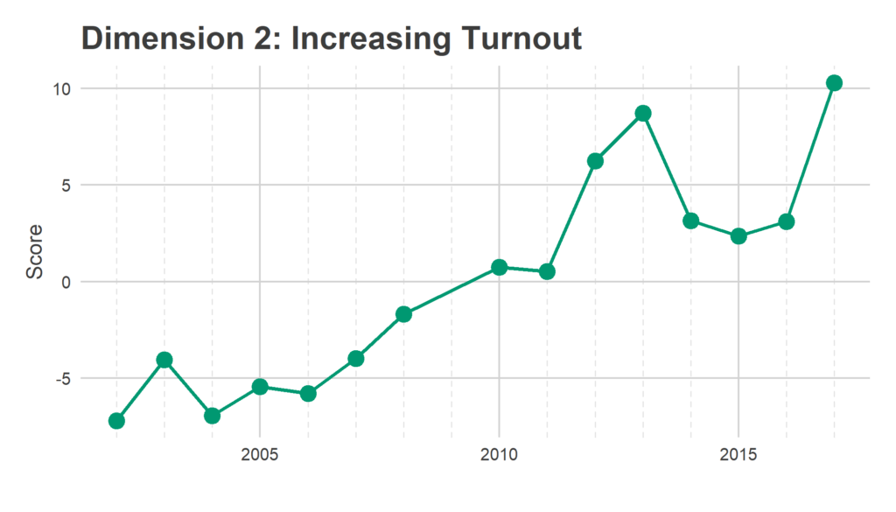
Estimating Turnout: Correlated Districts

Slide 23
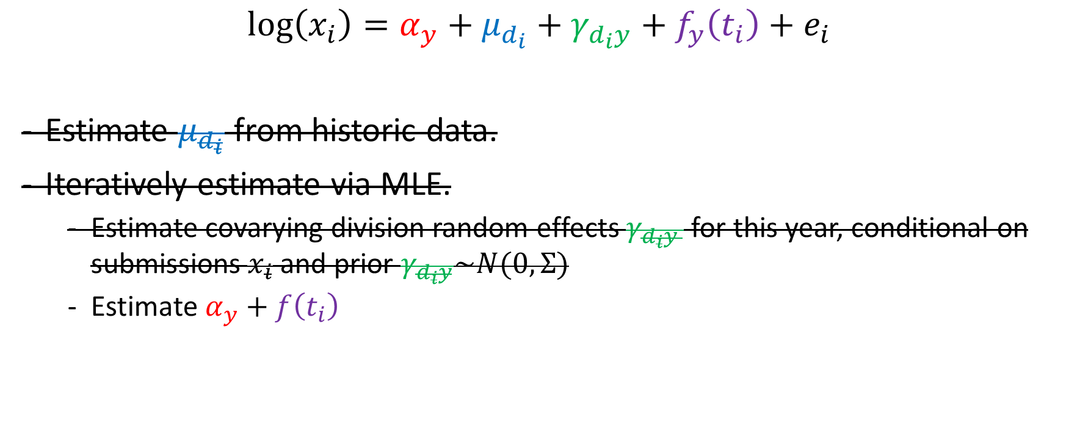
Predicting this model
$$\log\left(x_{i}\right)=α_{y}+μ_{d_{i}}+γ_{d_{i}y}+f_{y}\left(t_{i}\right)+e_{i}$$
Estimate $μ_{d_{i}}$ from historic data.
Iteratively estimate via MLE.
Estimate covarying division random effects $γ_{d_{i}y }$ for this year, conditional on submissions $x_{i}$ and prior $γ_{d_{i}y}\sim N(0, Σ)$
Estimate $α_{y}+f\left(t_{i}\right)$

Slide 24

Estimating Turnout: Time Pattern
Even after we’ve adjusted for (a) each division’s baseline turnout and (b) covarying swings, how do we compare data at 8am with data from 2pm?
$$\log\left(x_{i}\right)=α_{y}+μ_{d}+γ_{dy}+f\left(t\right)+e_{i}$$

Slide 25

Estimating Turnout: Time Pattern
Even after we’ve adjusted for (a) each division’s baseline turnout and (b) covarying swings, how do we compare data at 8am with data from 2pm?
$\log\left(x_{i}\right)=α_{y}+μ_{d}+γ_{dy}+f(t)$ $+{ e}_{i}$
$$α_{y}+f\left(t\right)=\log\left(x_{i}\right)− μ_{d}−γ_{dy}−e_{i}$$

Slide 26

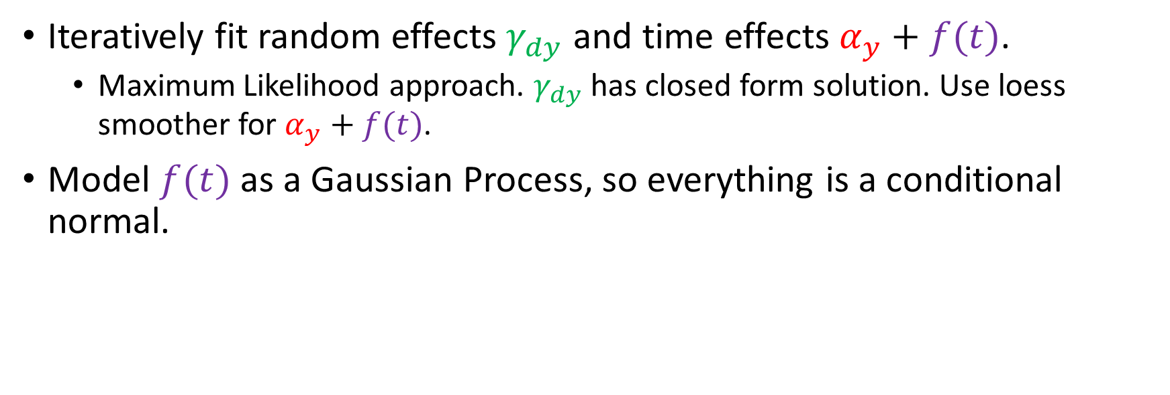
Two methods to fit the model
$\log\left(x_{i}\right)=α_{y}+μ_{d}+γ_{dy}+f(t)$ $+{ e}_{i}$
Iteratively fit random effects $γ_{dy}$ and time effects $α_{y}+f(t)$.
Maximum Likelihood approach. $γ_{dy}$ has closed form solution. Use loess smoother for $α_{y}+f(t)$.
Model $f(t)$ as a Gaussian Process, so everything is a conditional normal.

Slide 27
Turnout Tracker: the challenges
Different divisions have different baseline turnouts.
Divisions may swing together.
We don’t know the time pattern, and no ground truth.
There’s *definitely* selection bias into who shares.
Knowing uncertainty in the estimate is everything.

Slide 28
Turnout Tracker: the challenges
Different divisions have different turnouts.
Use each division’s baseline rate from past elections.
Divisions may swing together.
Estimate the covariance in divisions’ swings from election to election.
We don’t know the time pattern , and no ground truth.
Estimate it on the fly. 😎
There’s *definitely* selection bias into who shares.
oof.
Knowing uncertainty in the estimate is everything. ???

Slide 29
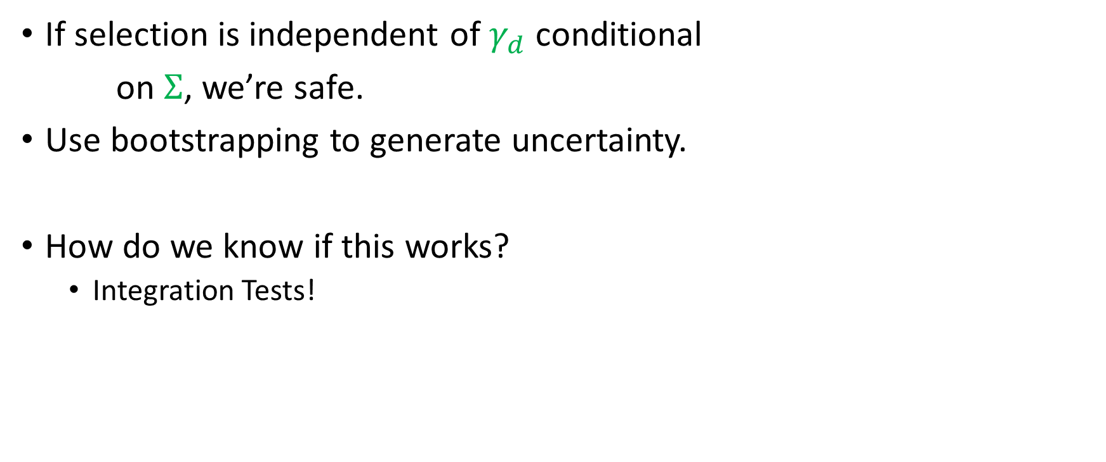
Selection bias & Uncertainty
If selection is independent of $γ_{d}$conditional
on $Σ$, we’re safe.
Use bootstrapping to generate uncertainty.
How do we know if this works?
Integration Tests!

Slide 30
Practical notes for a live tool
Need aggressive handling of outliers.
Winsorizing and sanity checks.
Provide understanding-based visualizations.
Maps, plots of intermediate calculations.
Everything you look at to debug should be a unit test or an output.

Slide 31
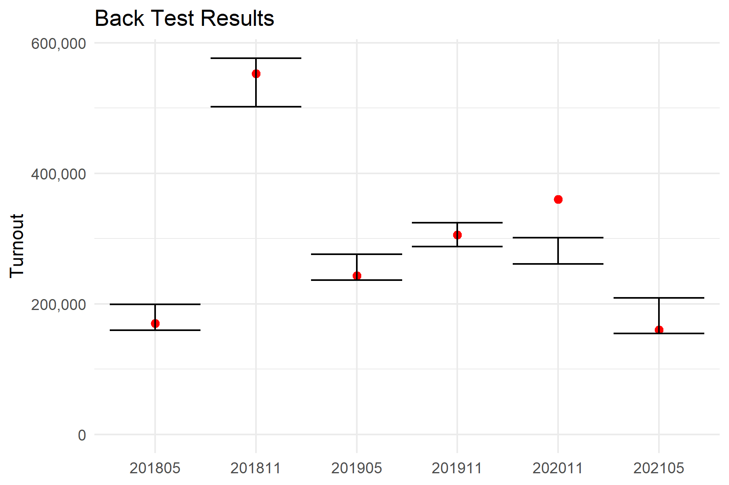
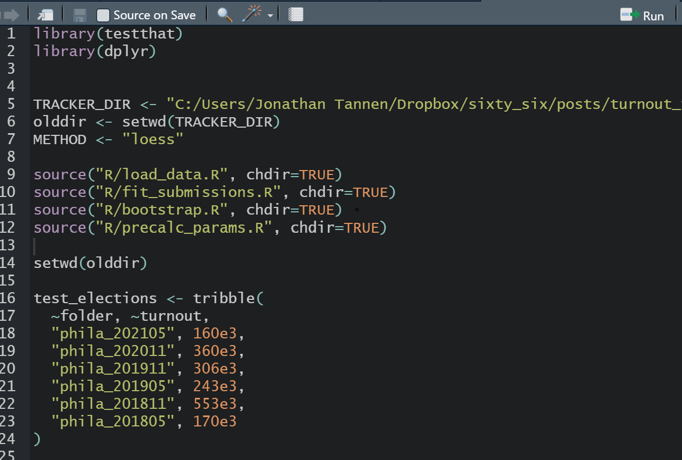
Integration/Back Tests
Test full runs of the package on known results.
Tests for
Composition errors
Correctness errors

Slide 32
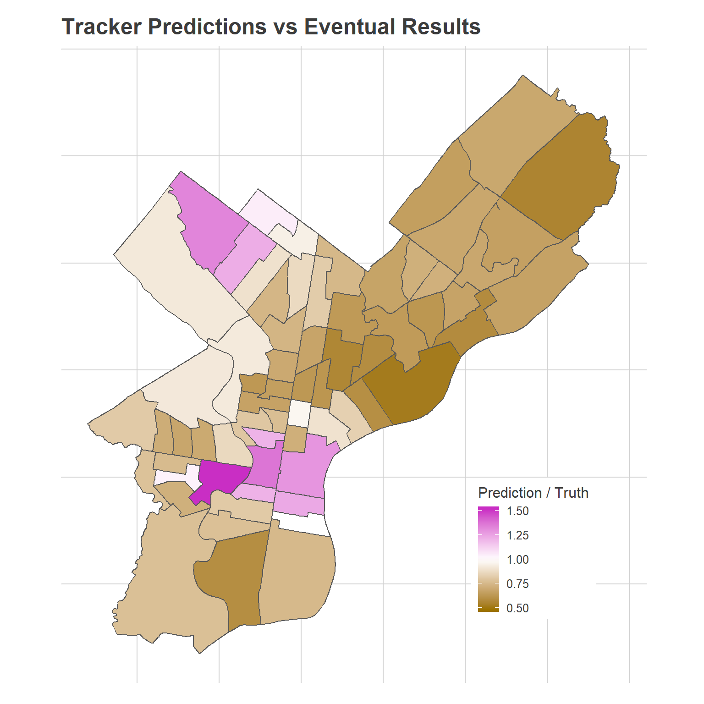
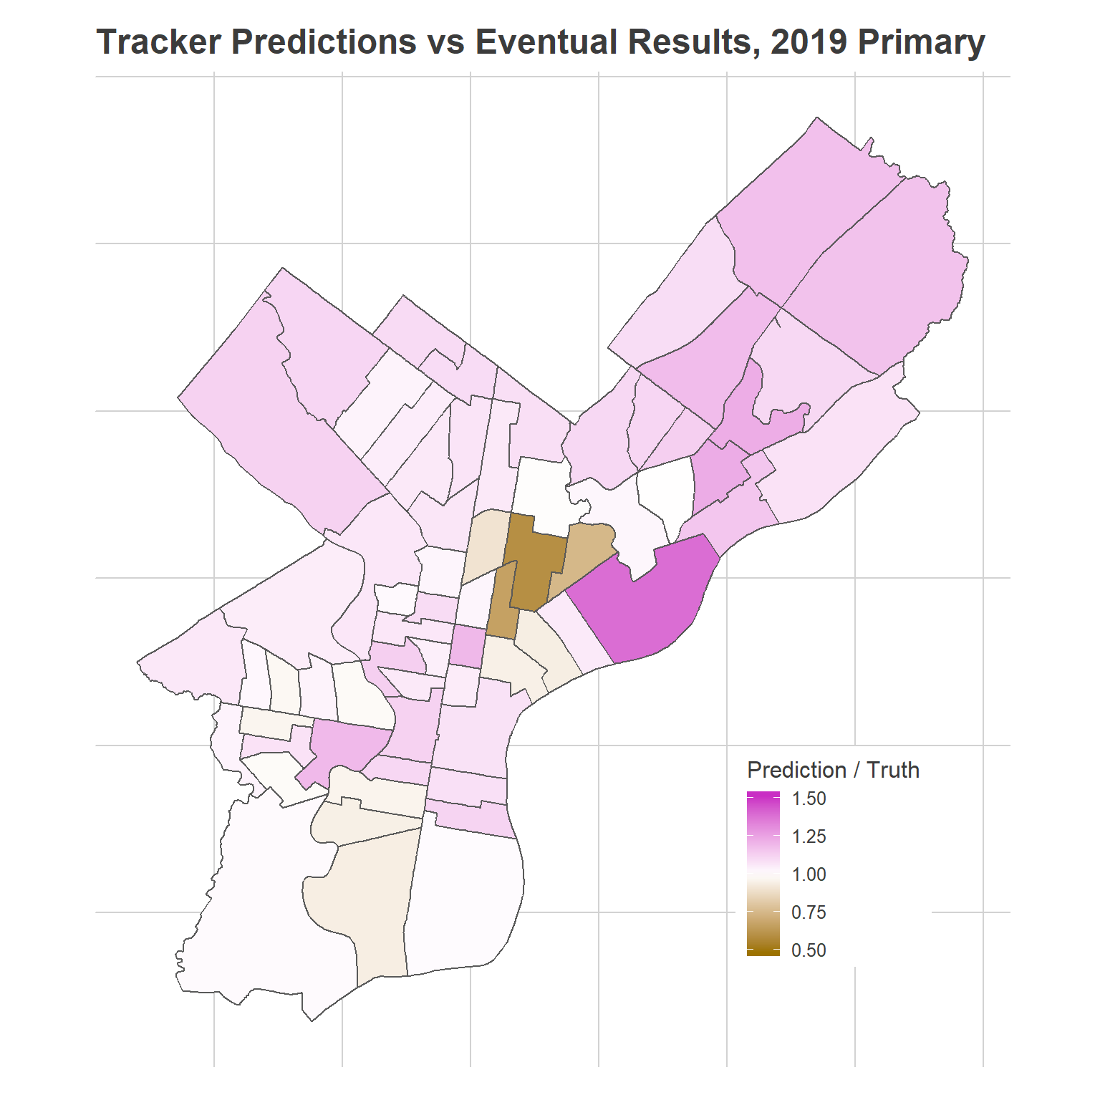
What broke the Tracker in 2020?

Slide 33
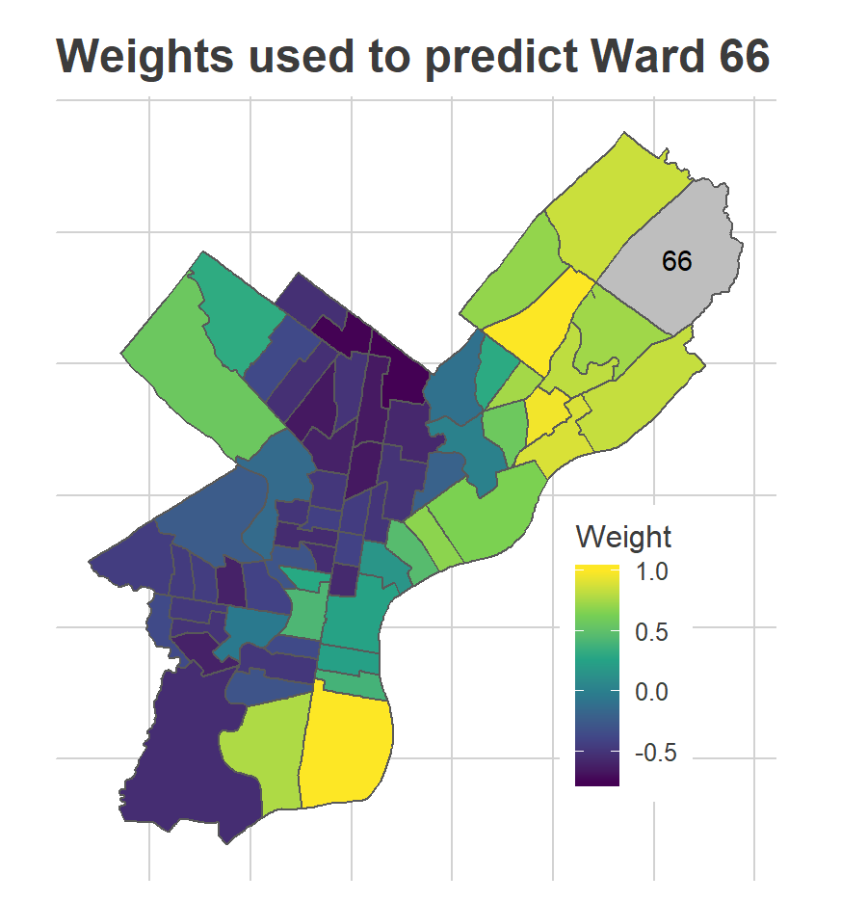
What broke the Tracker in 2020?

Slide 34
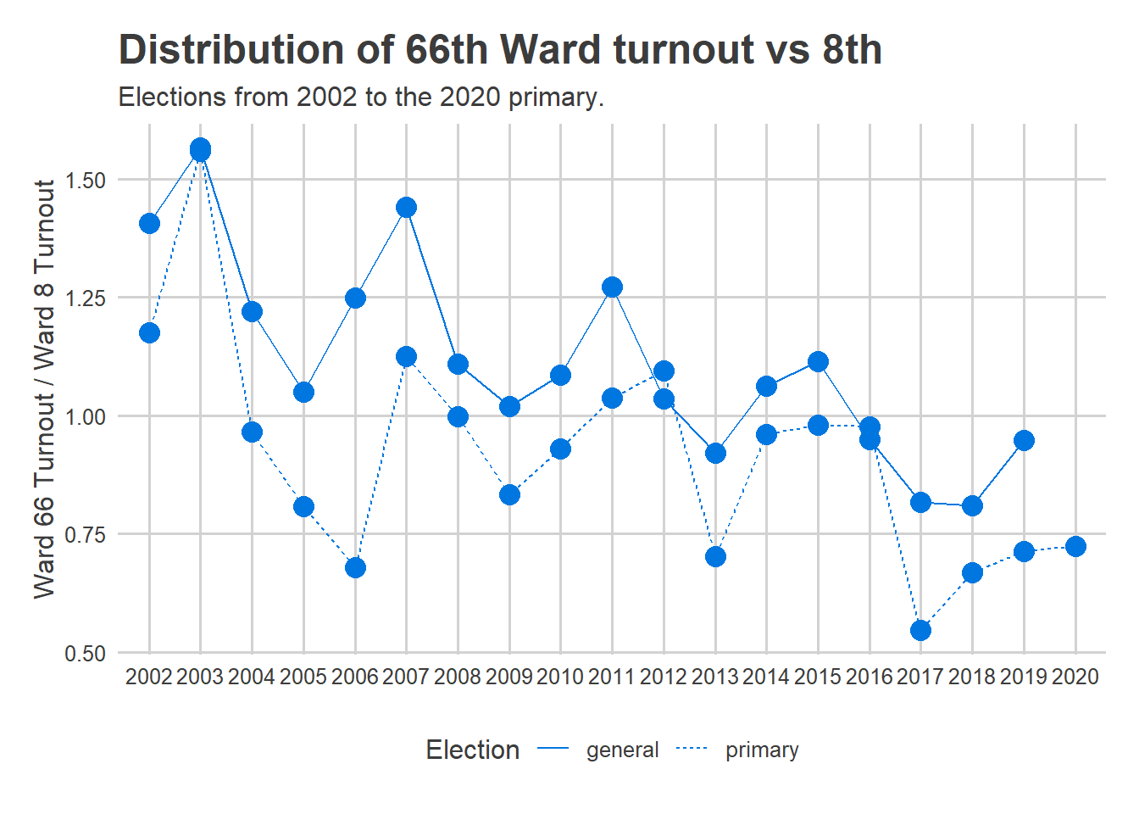
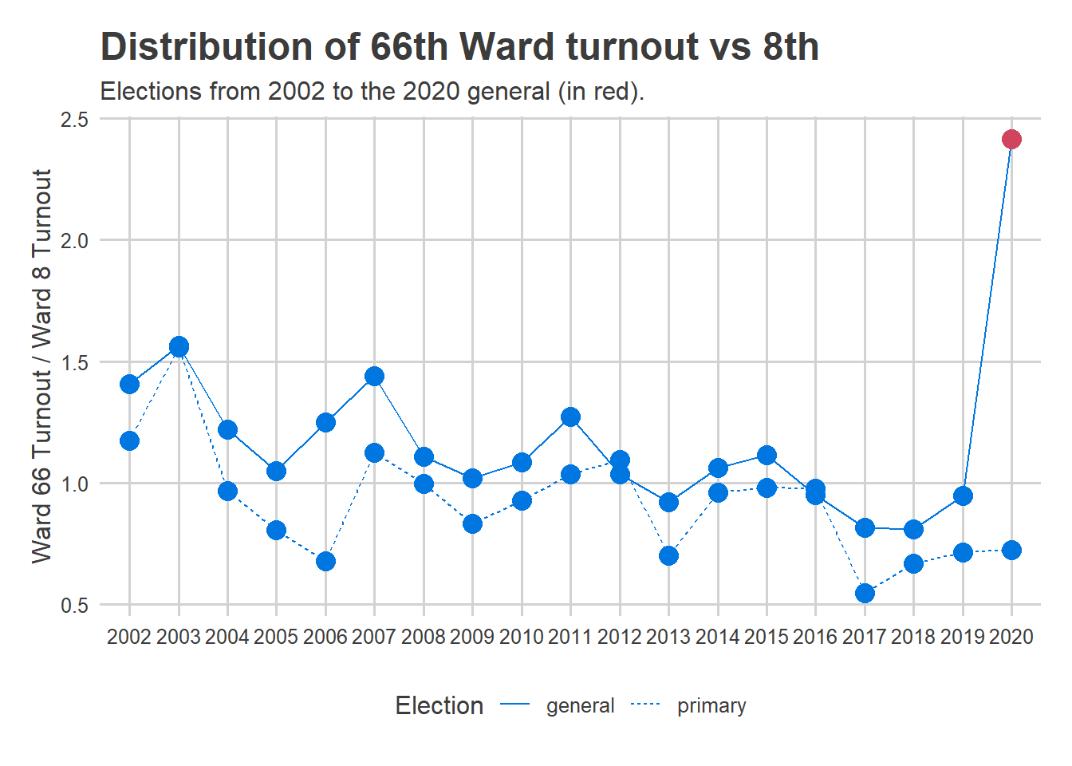
What broke the Tracker in 2020?

Slide 35
The Turnout Tracker: The Tech
Google Form to collect responses
R functions that download google sheet, process data.
R functions that generate predictions and bootstraps.
RMarkdown document generates HTML report.
httr command to push html to website.
TODO:
Docker Container
https://github.com/jtannen/turnout_tracker

Slide 36
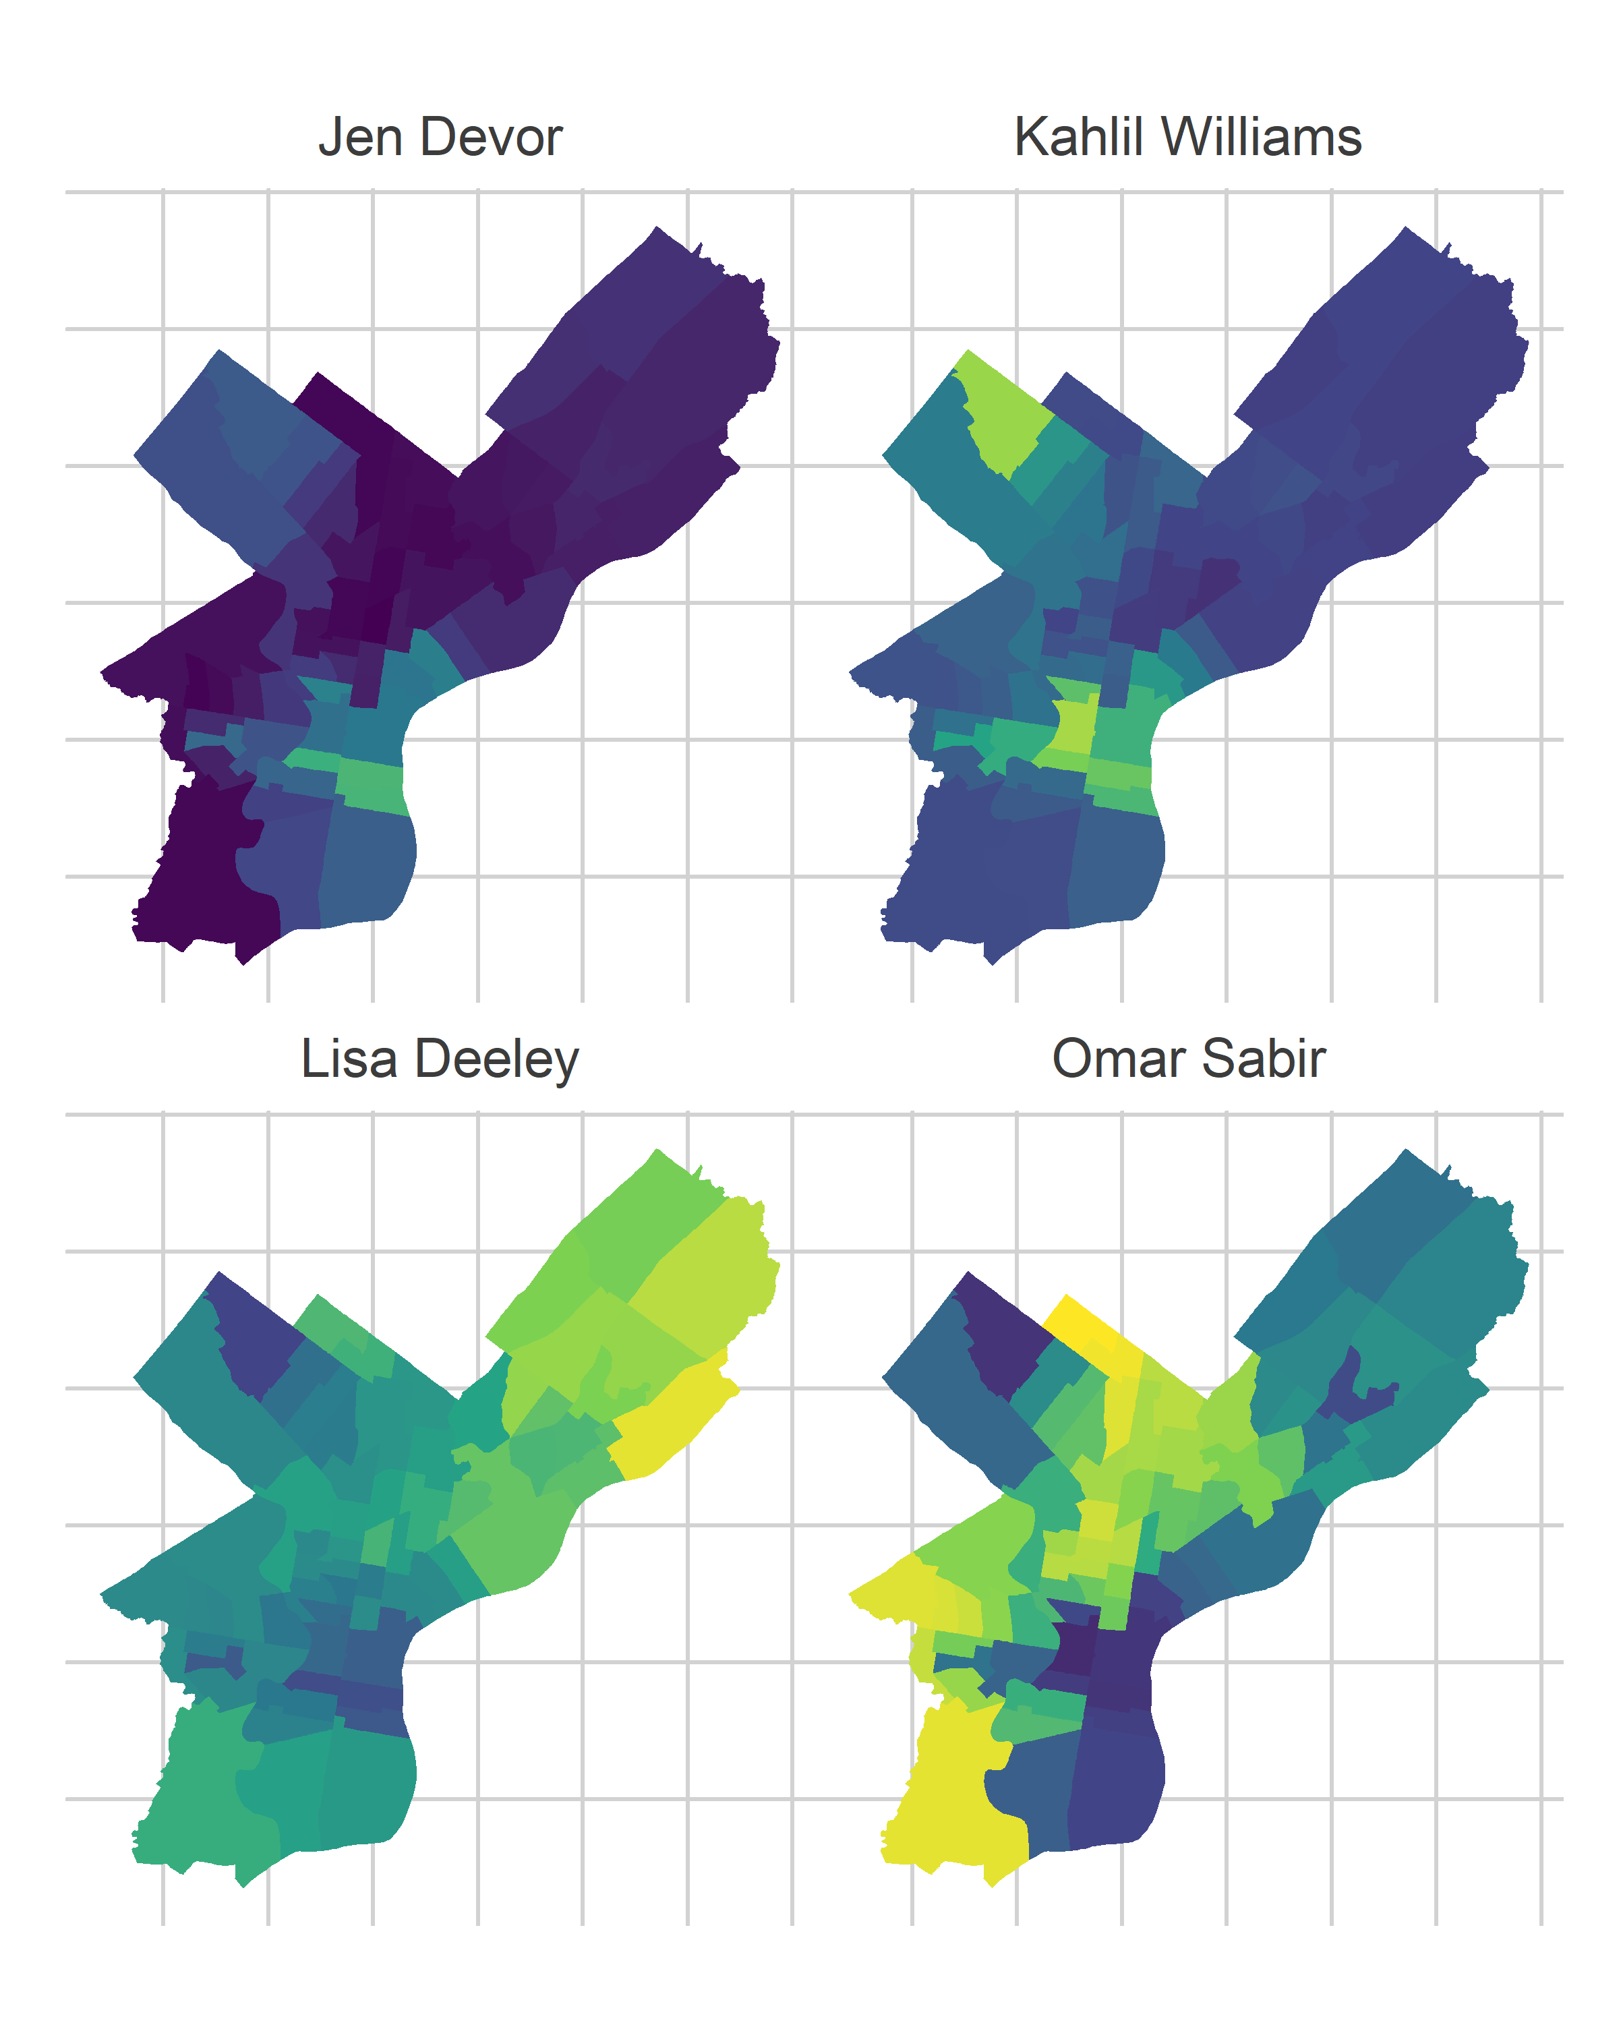
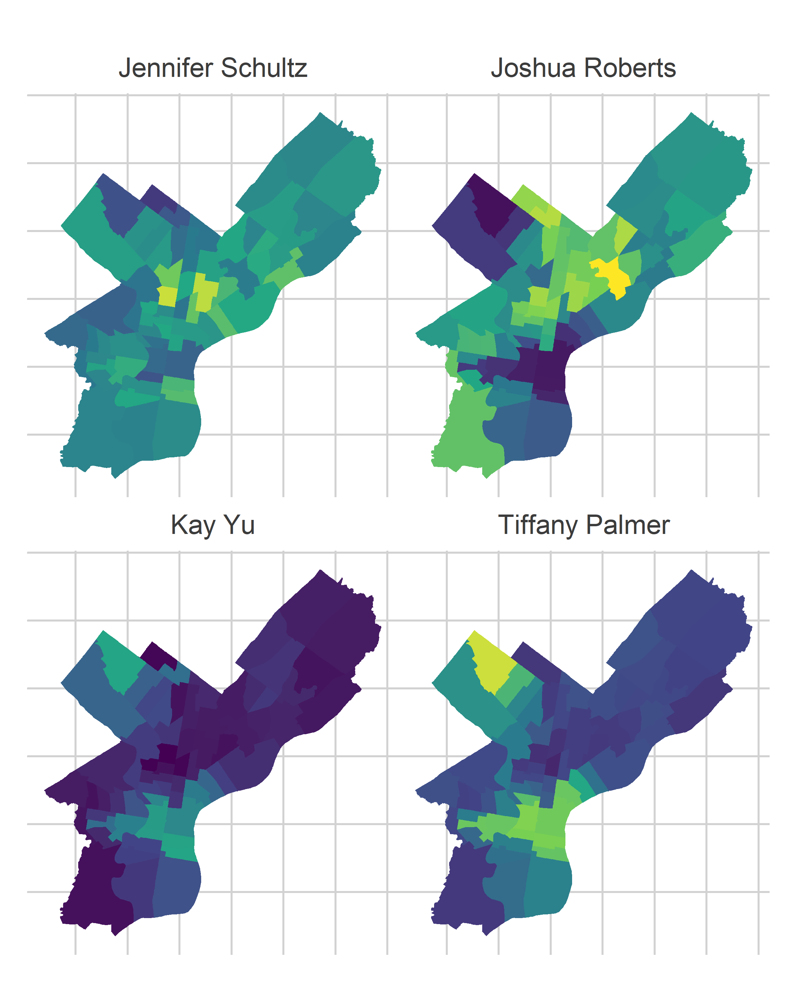
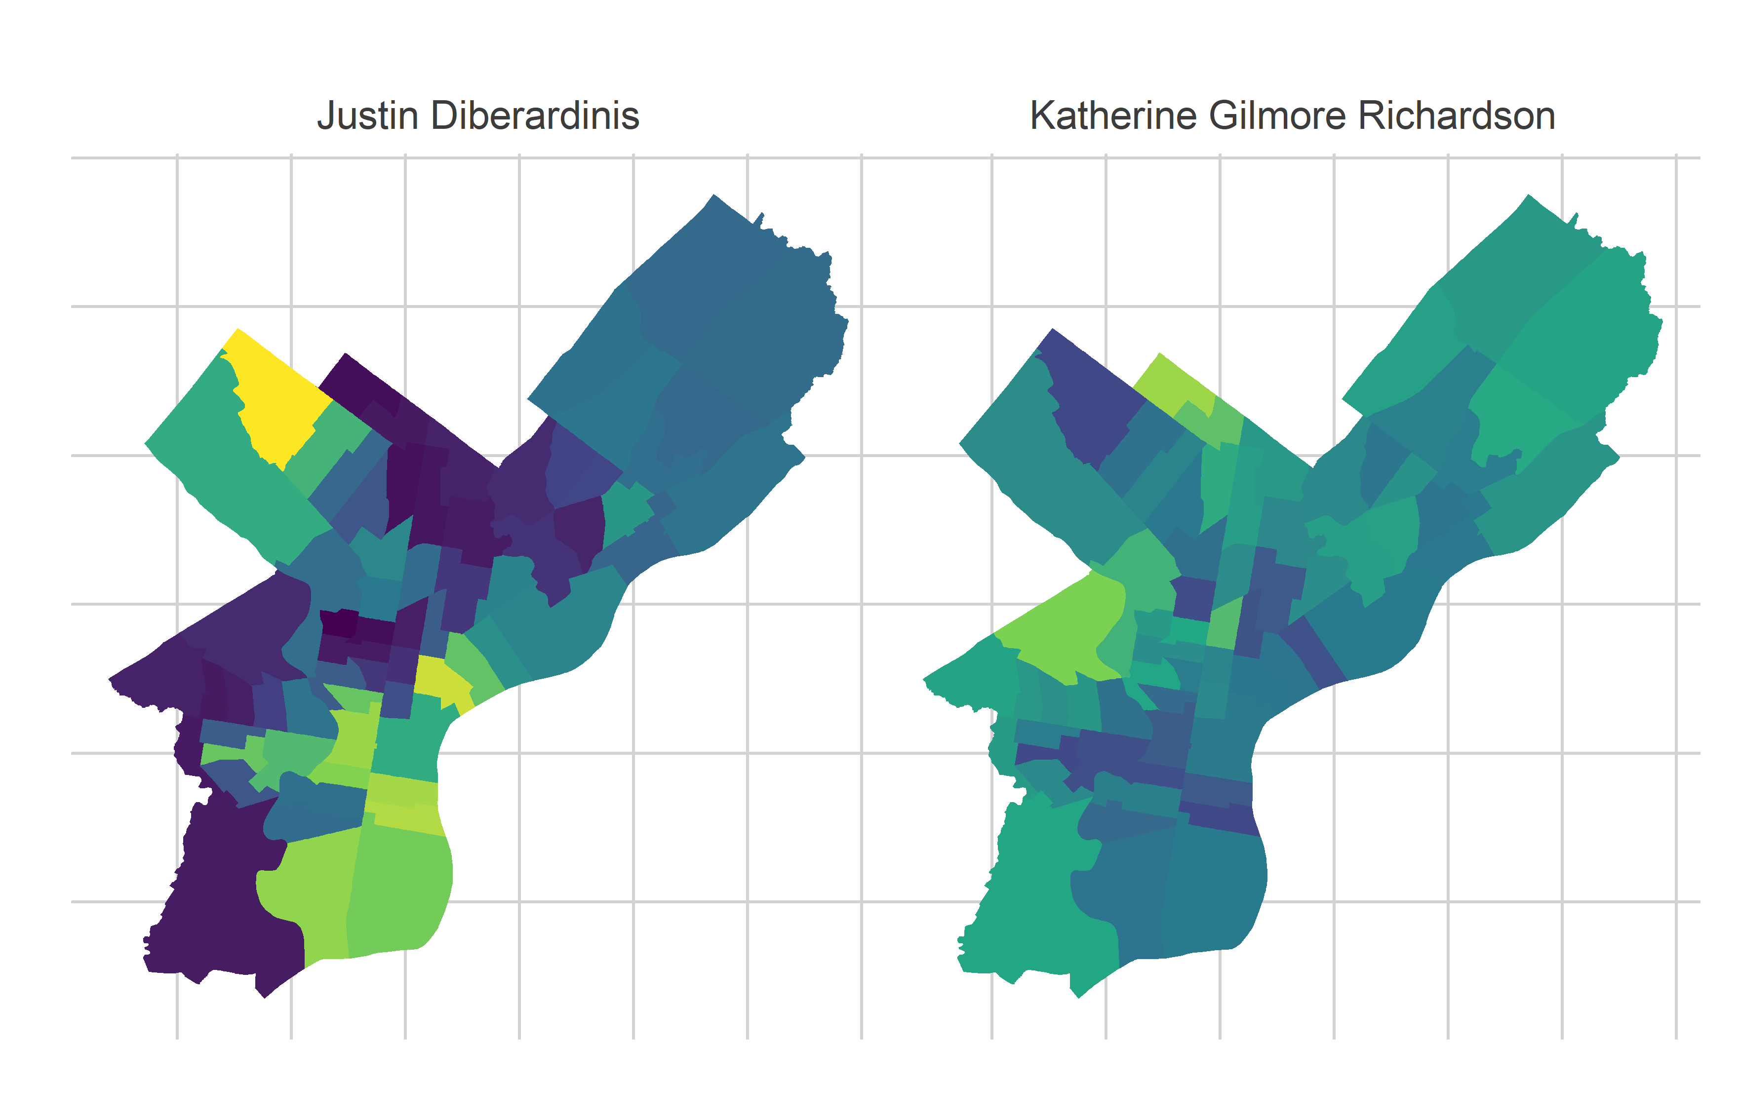
Philadelphia’s Voting Blocs

Slide 37
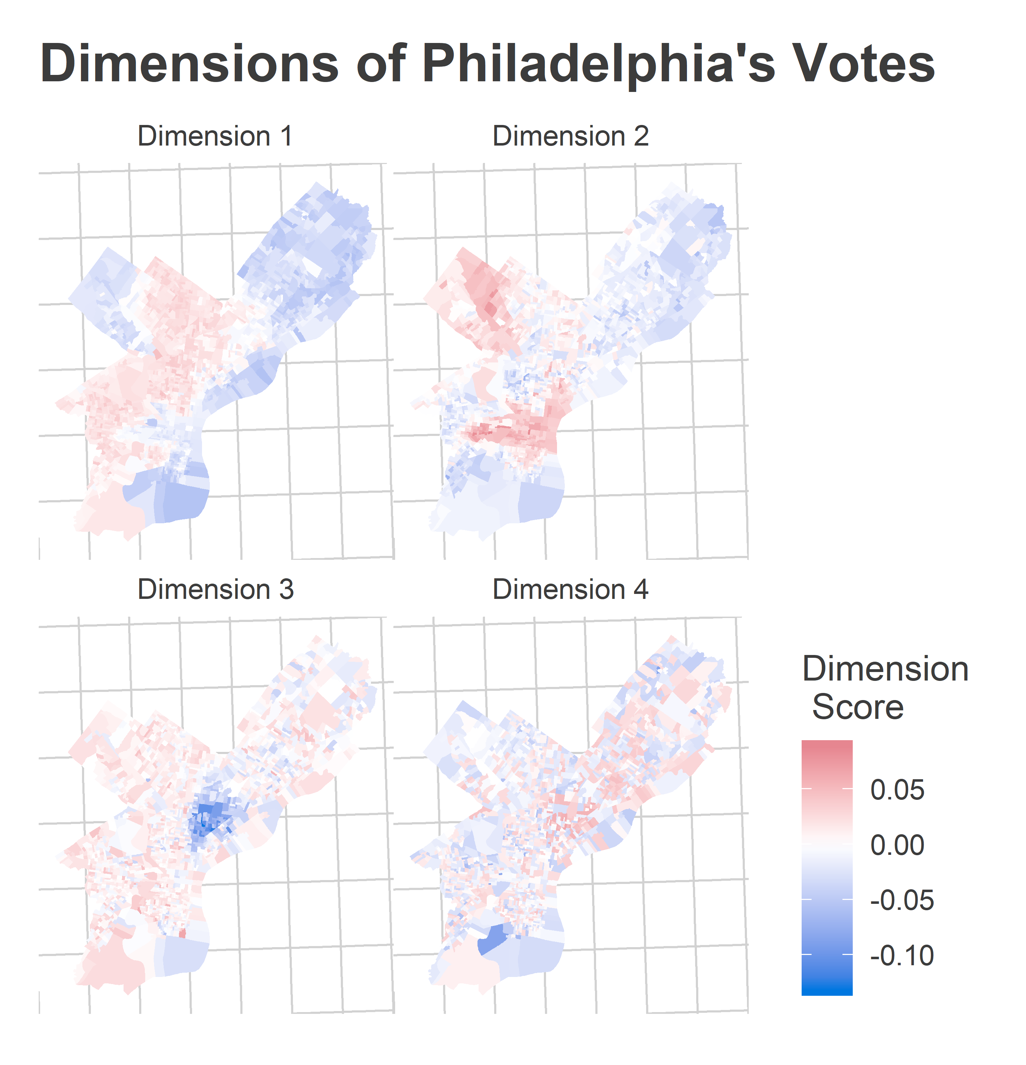
Philadelphia’s Voting Blocs
SVD to the rescue!

Slide 38
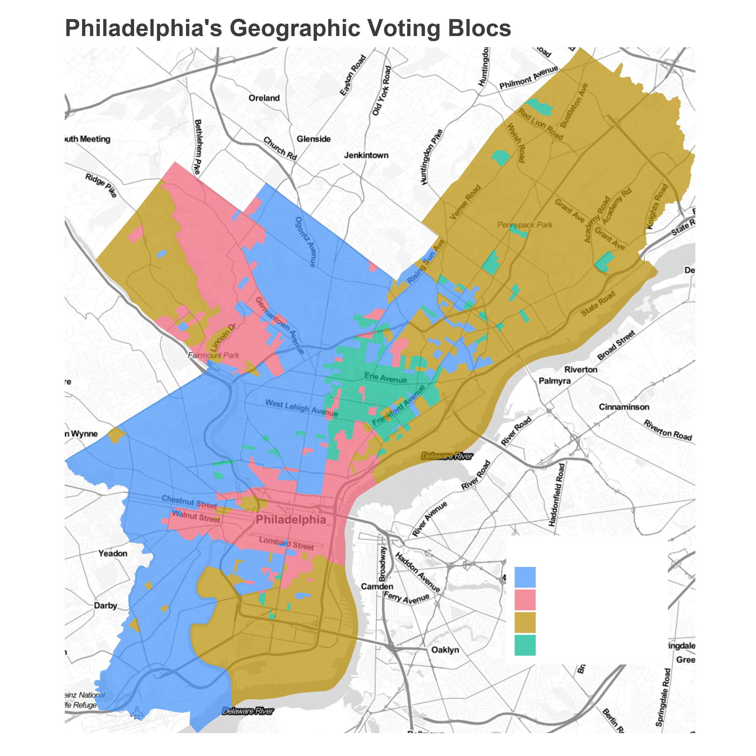
Philadelphia’s Voting Blocs
SVD + buckets to the rescue!

Slide 39
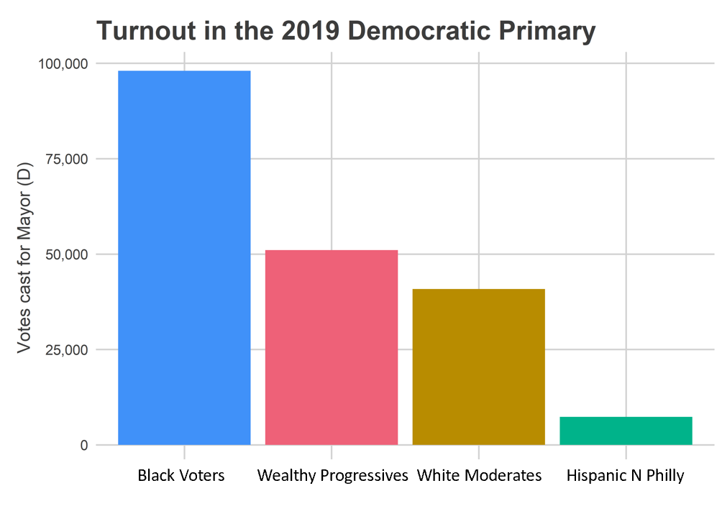
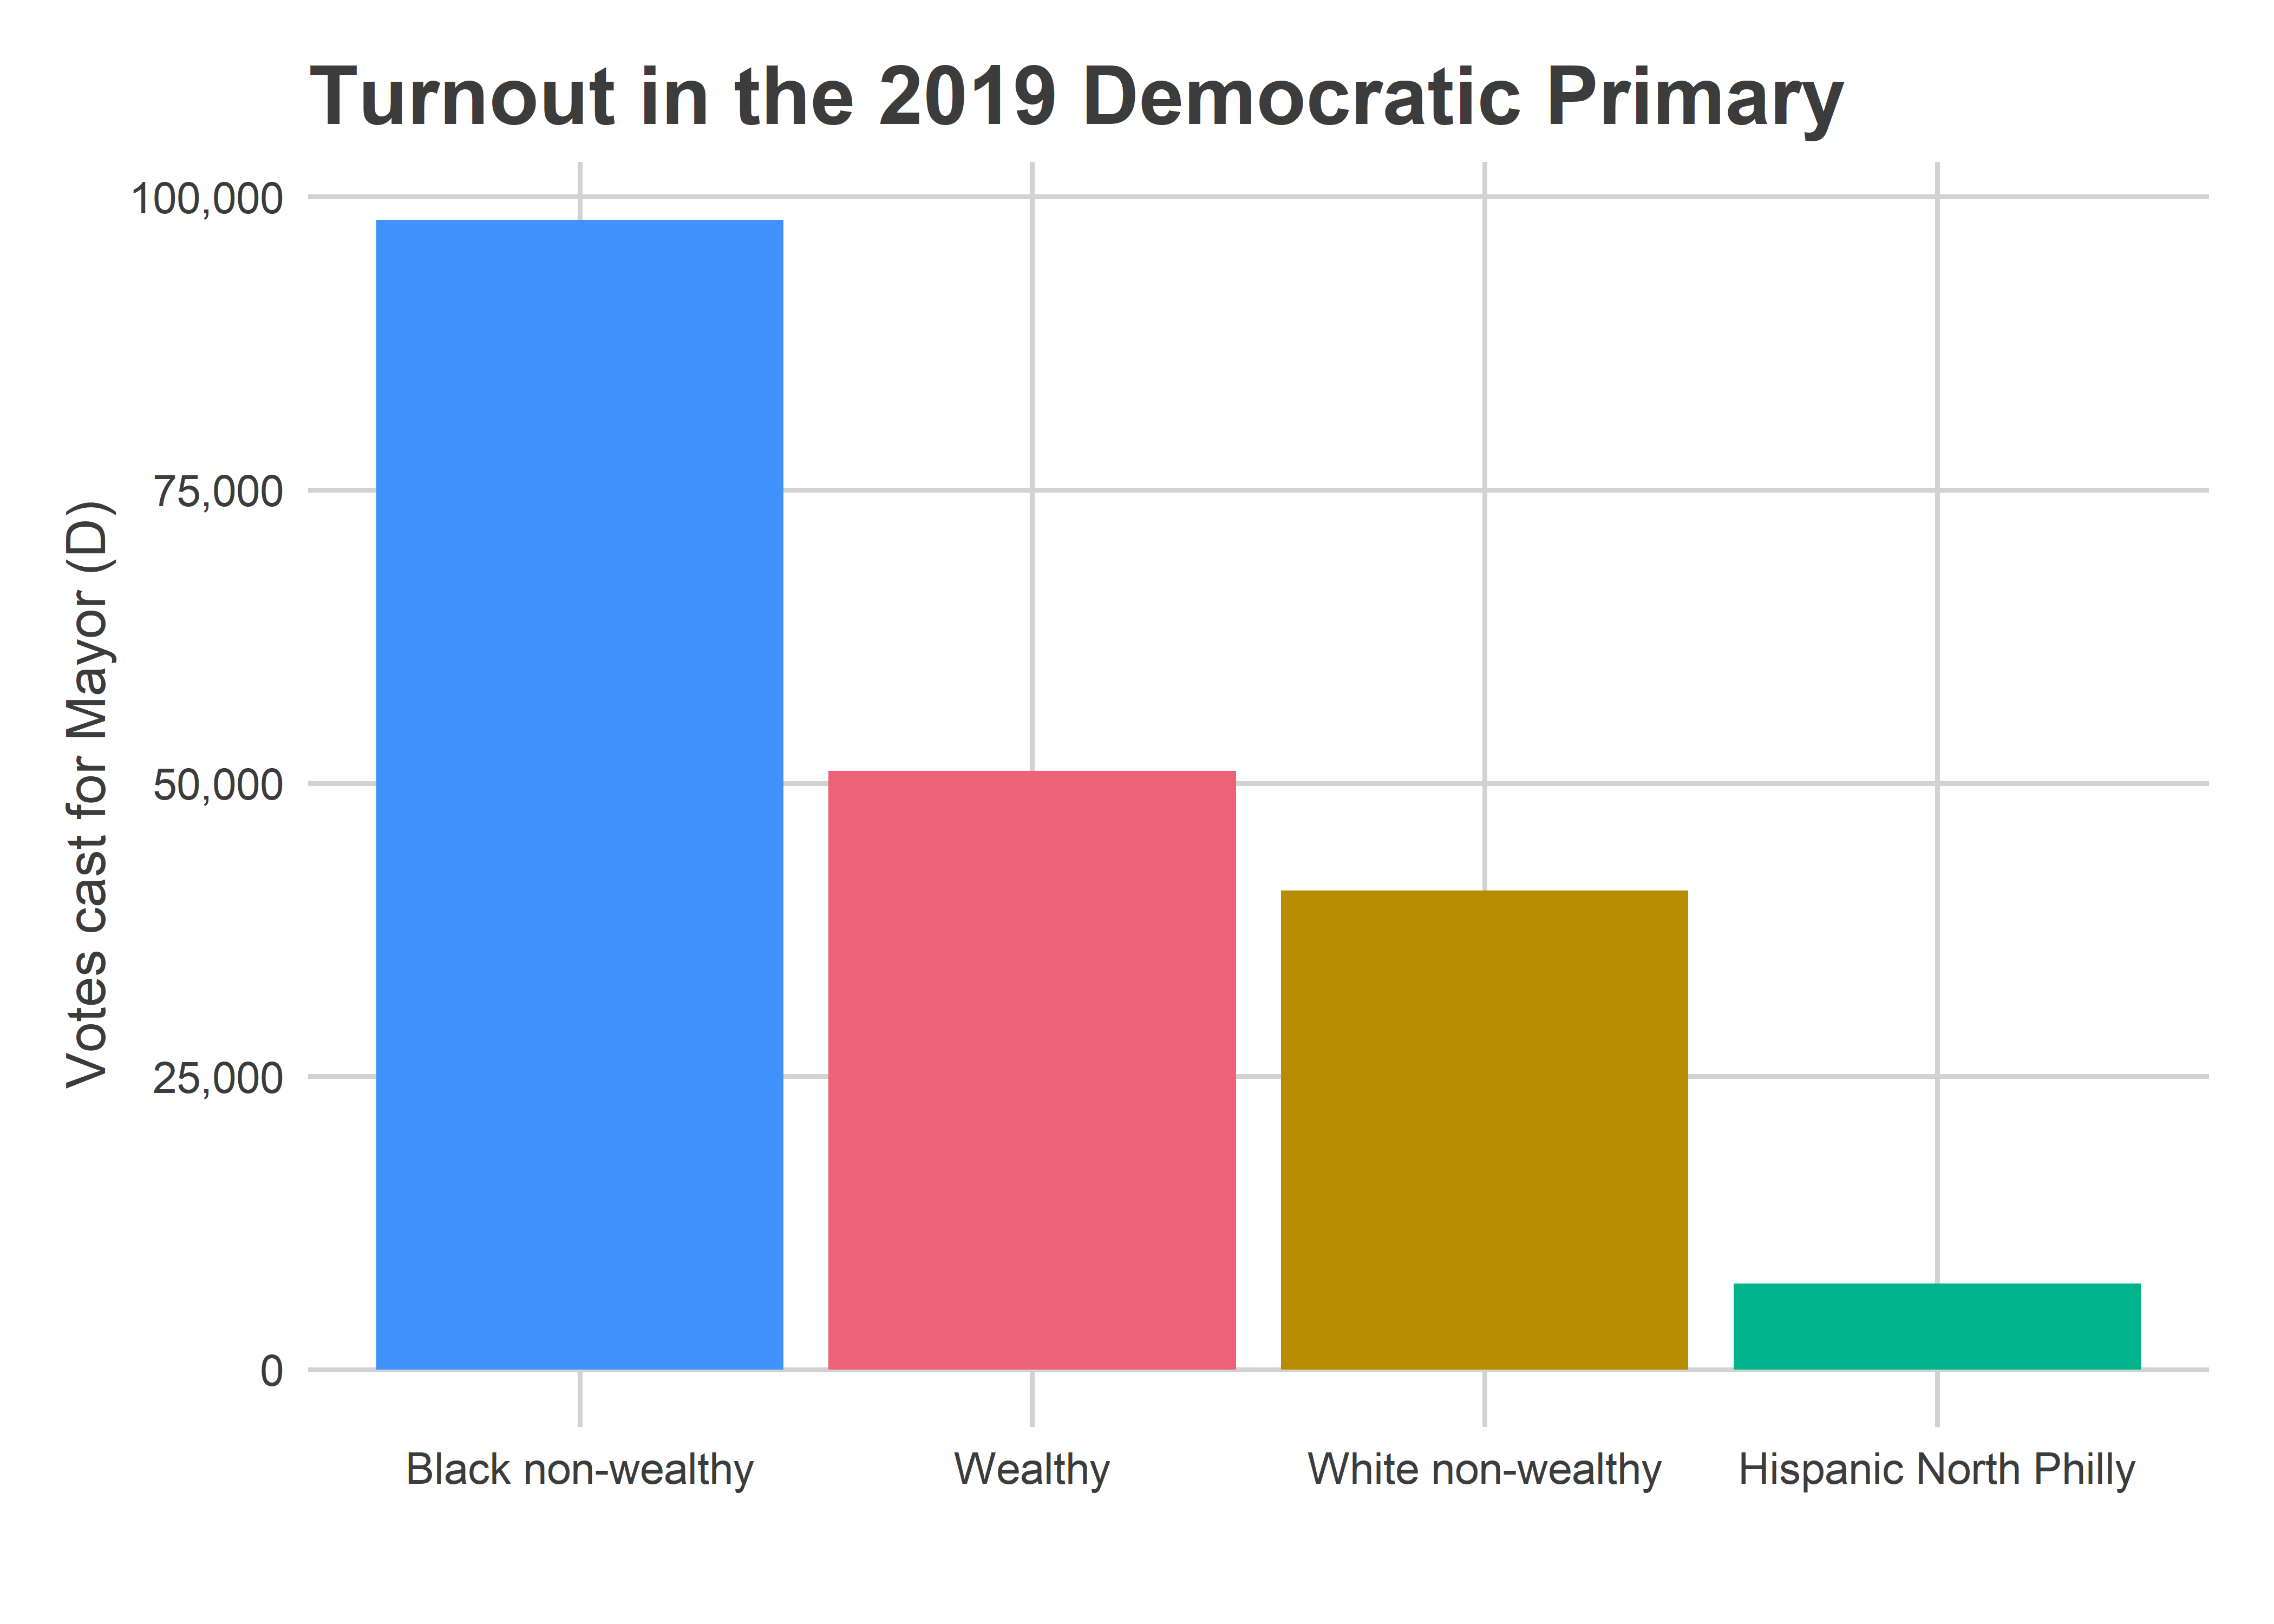
Philadelphia’s Voting Blocs
Black Voters Wealthy Progressives White Moderates Hispanic N Philly

Slide 40
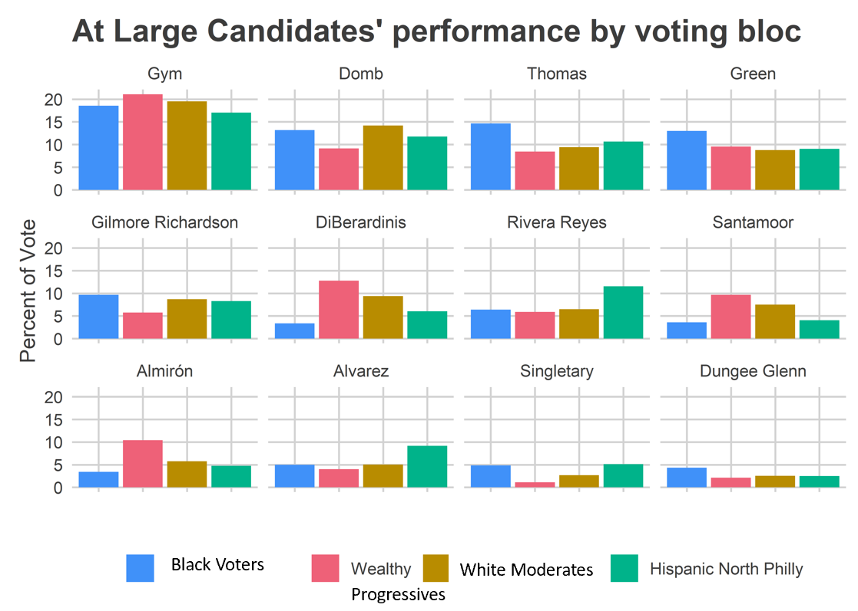
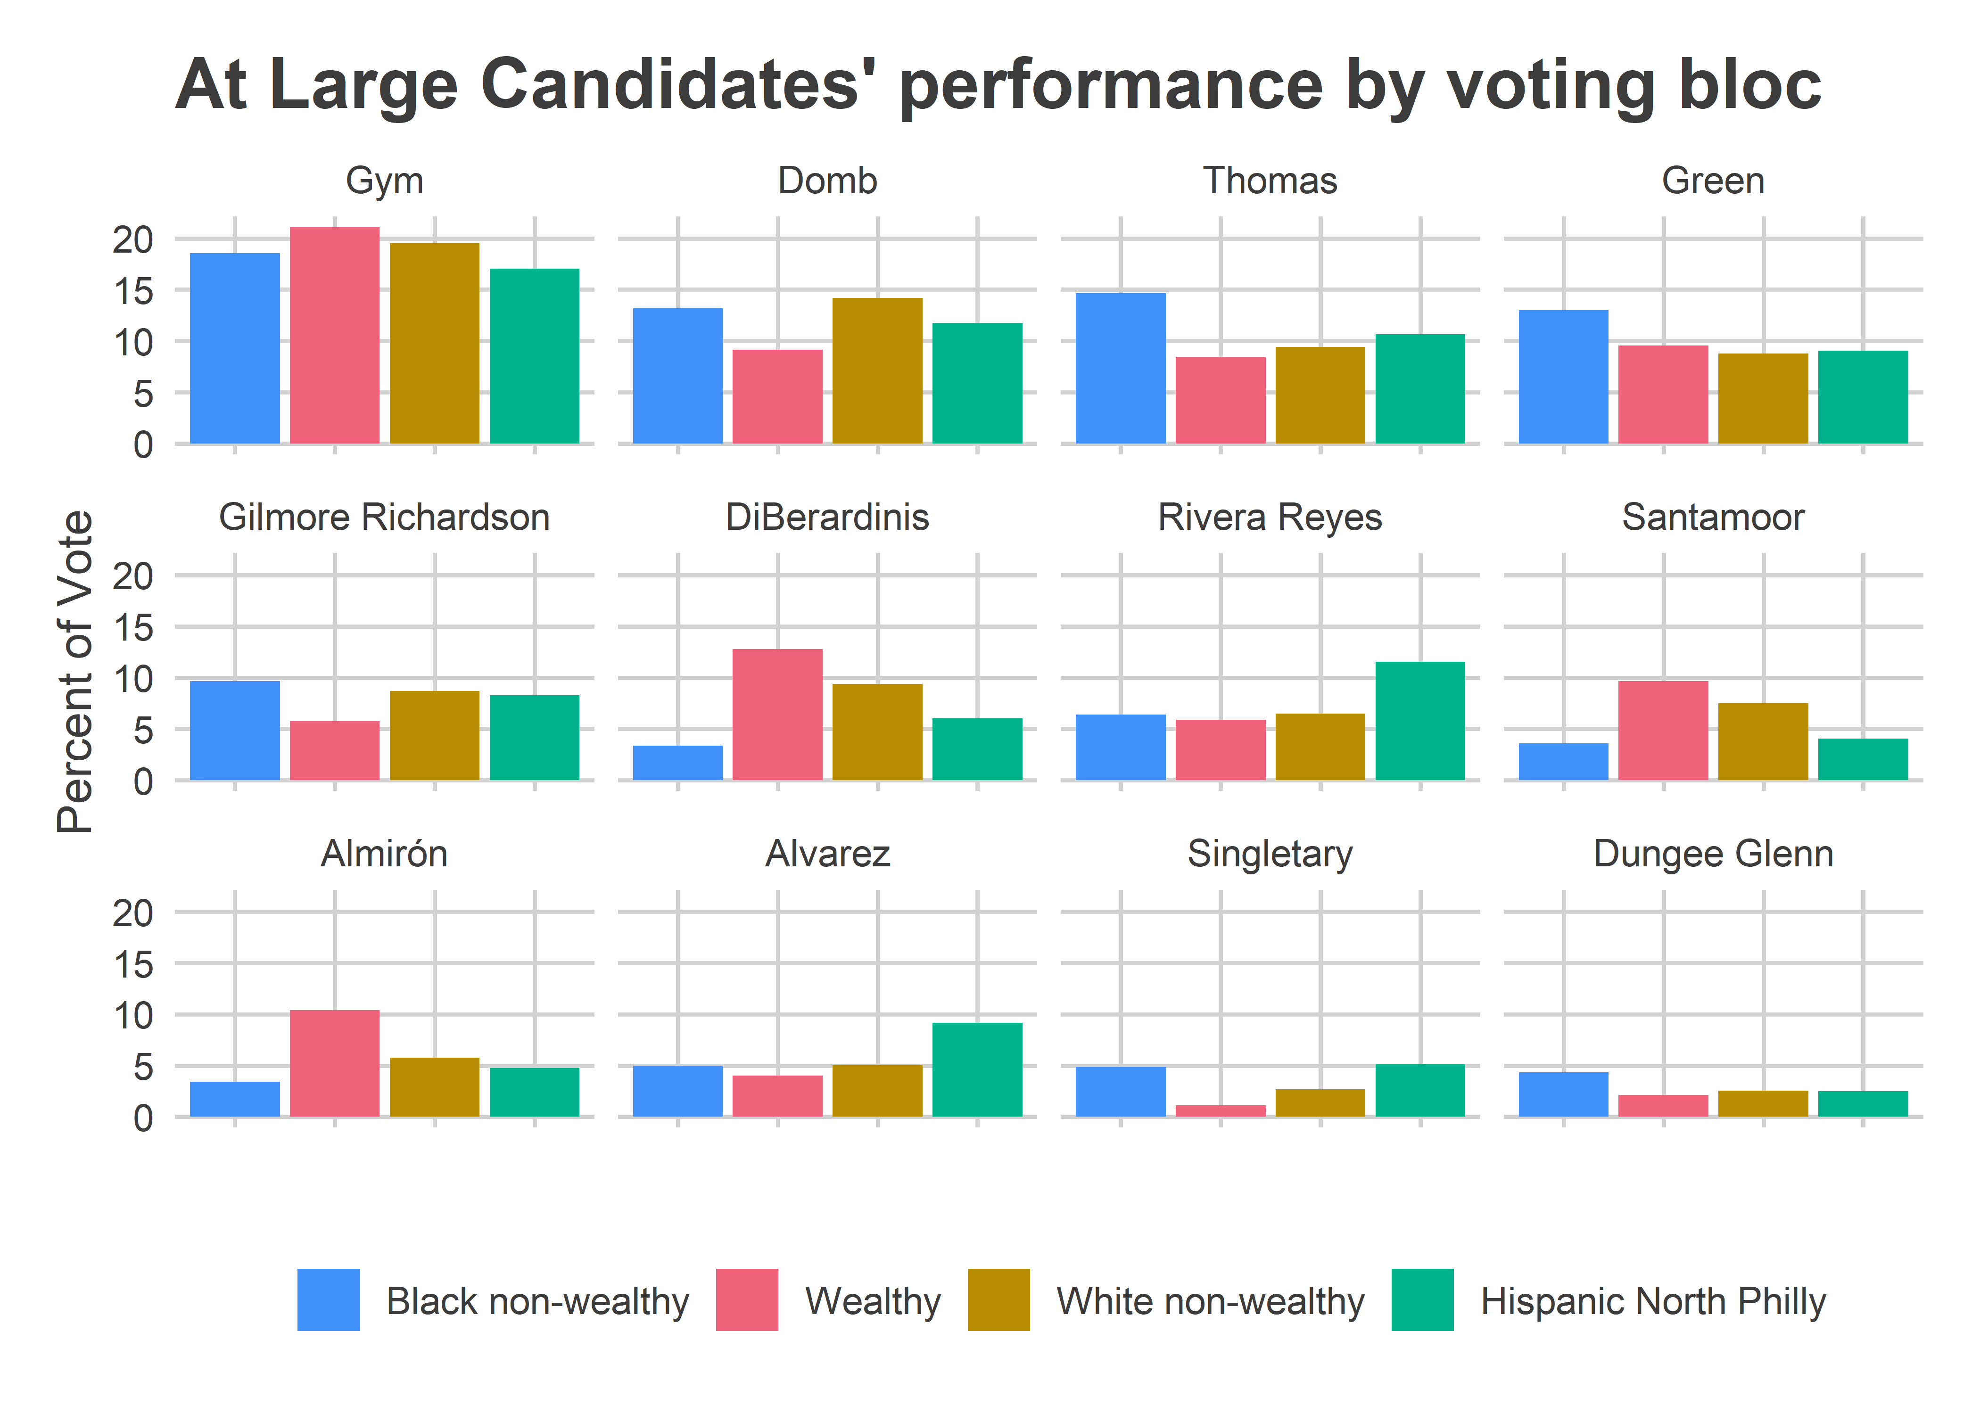
Philadelphia’s Voting Blocs
Black Voters
Progressives
White Moderates

Slide 41
The end!
Questions?

Slide 42
Appendix

Slide 43
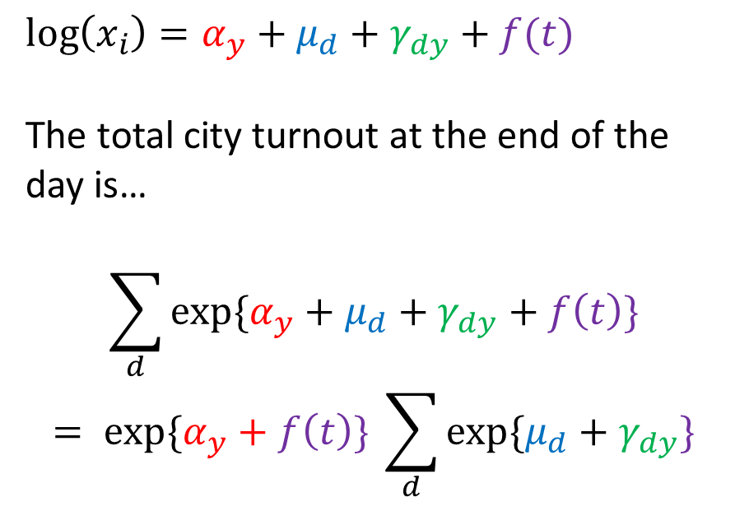
Estimating Turnout: Time Pattern
$$\log\left(x_{i}\right)=α_{y}+μ_{d}+γ_{dy}+f(t)$$
The total city turnout at the end of the day is…
$$\sum_{d}{exp⁡\{α_{y}+μ_{d}+γ_{dy}+f\left(t\right)\}}$$
$$= exp⁡\{α_{y}+f\left(t\right)\} \sum_{d}{exp⁡\{μ_{d}+γ_{dy}\}}$$

